Slide 1
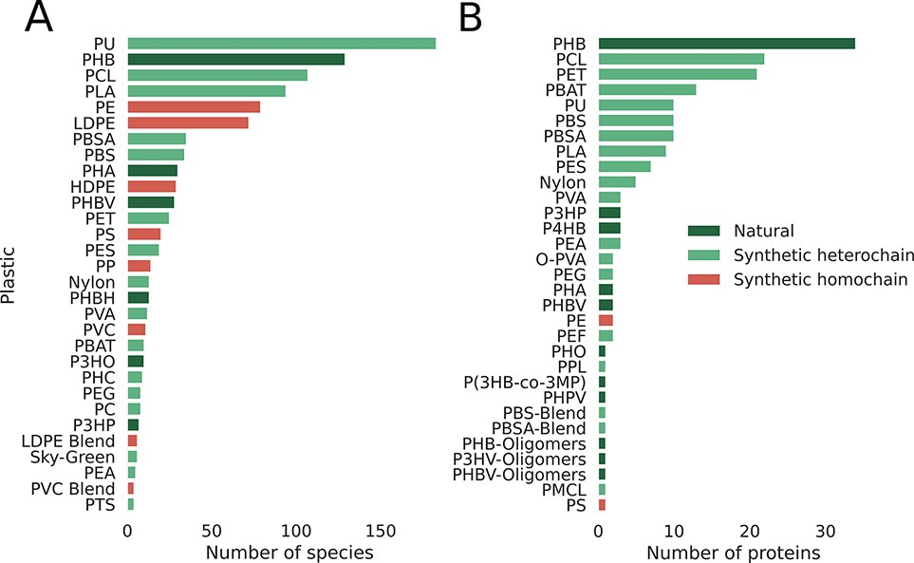
Figure 3. Database statistics per plastic, emphasizing the smaller number of reports for synthetic homochain polymers ...
Notes:
Figure 3. Database statistics per plastic, emphasizing the smaller number of reports for synthetic homochain polymers (those composed of only C–C backbones). A) Number of microbial species reported to degrade plastics. B) Number of proteins reported to break down plastics categorized by plastic type.
Unless provided in the caption above, the following copyright applies to the content of this slide: © The Author(s) 2022. Published by Oxford University Press.This is an Open Access article distributed under the terms of the Creative Commons Attribution License (https://creativecommons.org/licenses/by/4.0/), which permits unrestricted reuse, distribution, and reproduction in any medium, provided the original work is properly cited.

