Slide 1
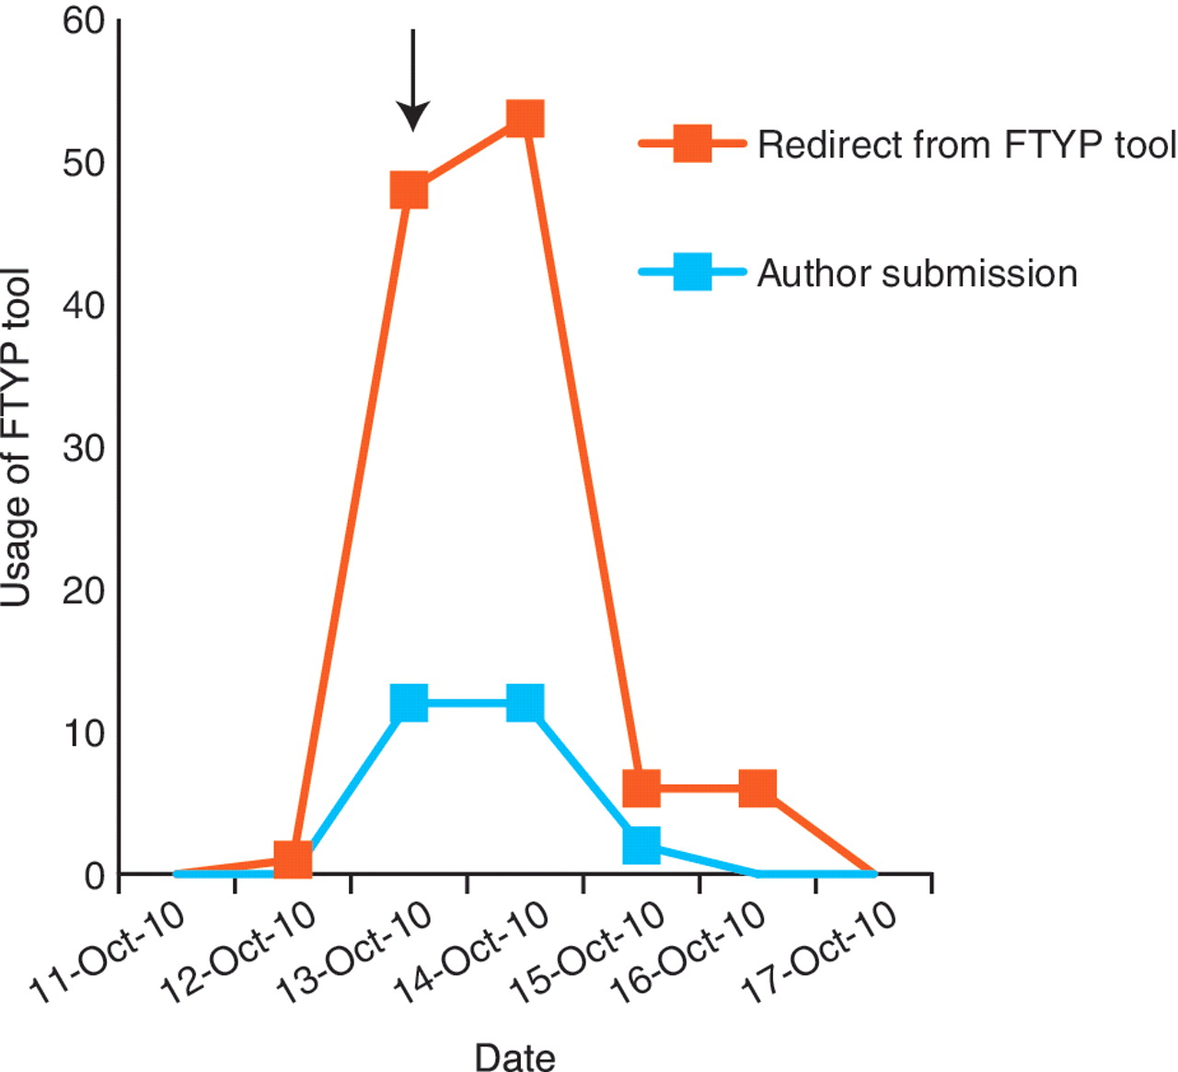
Figure 6. Community curation is most productive when authors are directed to a particular publication. A general e-mail ...
Notes:
Figure 6. Community curation is most productive when authors are directed to a particular publication. A general e-mail was sent to the Drosophila research community on 13 October 2010 (arrow), alerting them that we would be starting the weekly direct e-mailing the following week. This resulted in a small increase in successful author submissions, but resulted in a larger increase in unproductive redirects from the FTYP tool, where authors attempted to curate a paper that had already been skimmed or fully curated and were redirected to a page thanking them for their effort.
Unless provided in the caption above, the following copyright applies to the content of this slide: © The Author(s) 2012. Published by Oxford University Press.This is an Open Access article distributed under the terms of the Creative Commons Attribution Non-Commercial License (http://creativecommons.org/licenses/by-nc/3.0), which permits unrestricted non-commercial use, distribution, and reproduction in any medium, provided the original work is properly cited.

