Slide 1
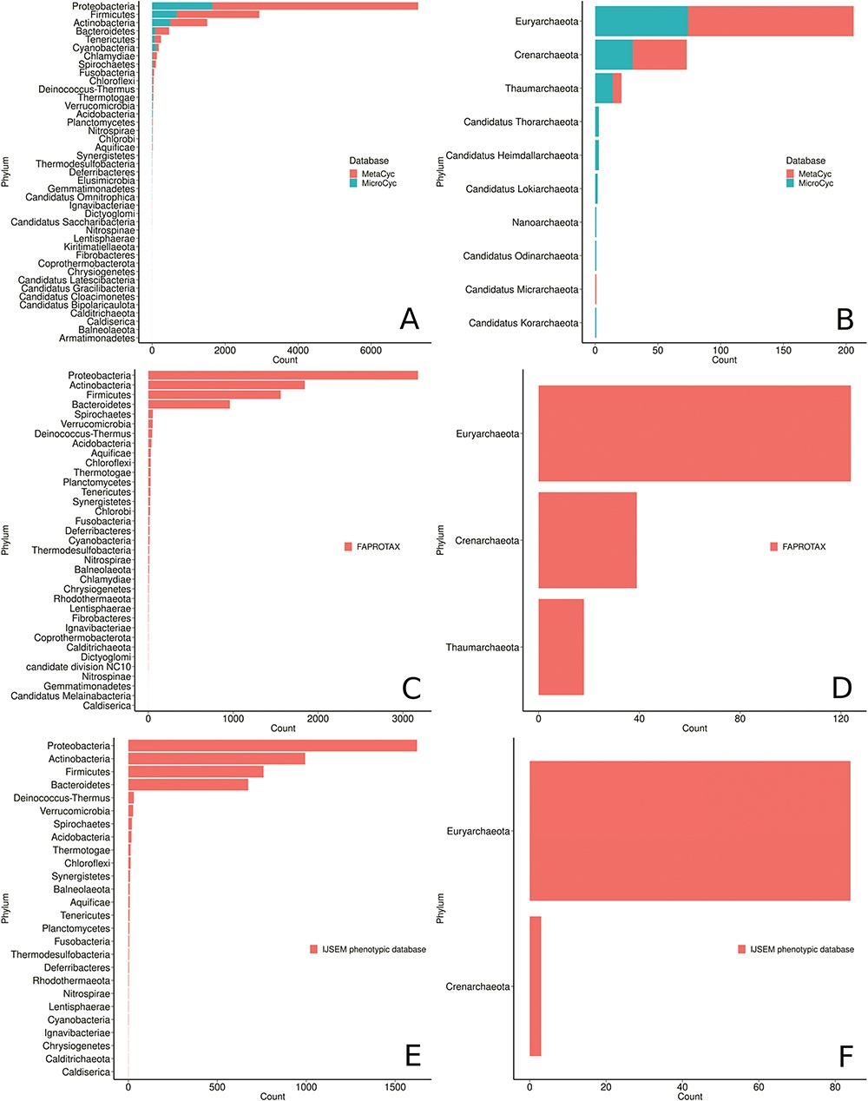
Figure 7 Phyla distribution in the MACADAM database according to their database of origin. (A) MetaCyc and MicroCyc ...
Notes:
Figure 7 Phyla distribution in the MACADAM database according to their database of origin. (A) MetaCyc and MicroCyc for bacterial organisms, (B) MetaCyc and MicroCyc for archaea organisms, (C) FAPROTAX for bacterial organisms, (D) FAPROTAX for archaea organisms, (E) IJSEM phenotypic database for bacterial organisms and (F) IJSEM phenotypic database for archaea organisms.
Unless provided in the caption above, the following copyright applies to the content of this slide: © The Author(s) 2019. Published by Oxford University Press.This is an Open Access article distributed under the terms of the Creative Commons Attribution License (http://creativecommons.org/licenses/by/4.0/), which permits unrestricted reuse, distribution, and reproduction in any medium, provided the original work is properly cited.

