Slide 1
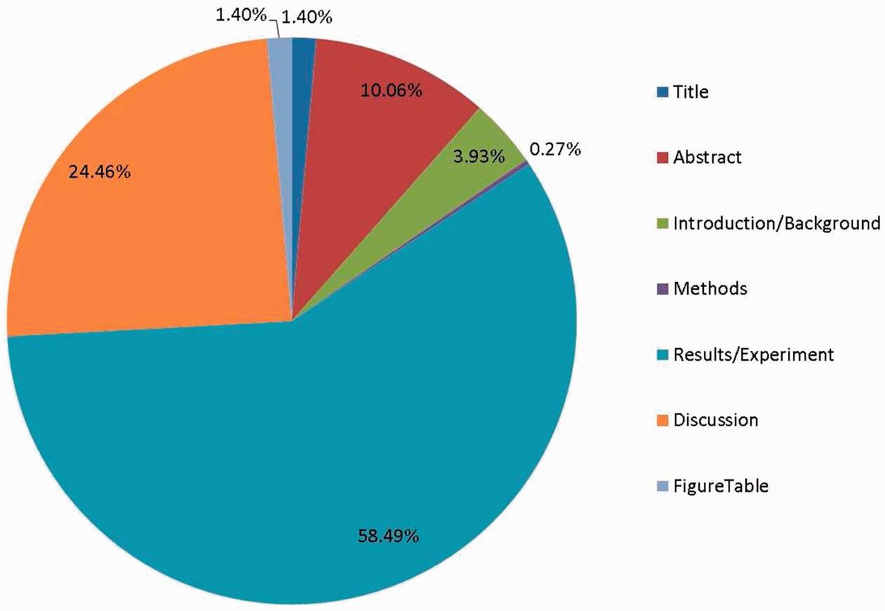
Figure 3. The proportion of annotated evidence text in different parts of the article.
Notes:
Figure 3. The proportion of annotated evidence text in different parts of the article.
Unless provided in the caption above, the following copyright applies to the content of this slide: Published by Oxford University Press 2014. This work is written by US Government employees and is in the public domain in the US.

