Slide 1
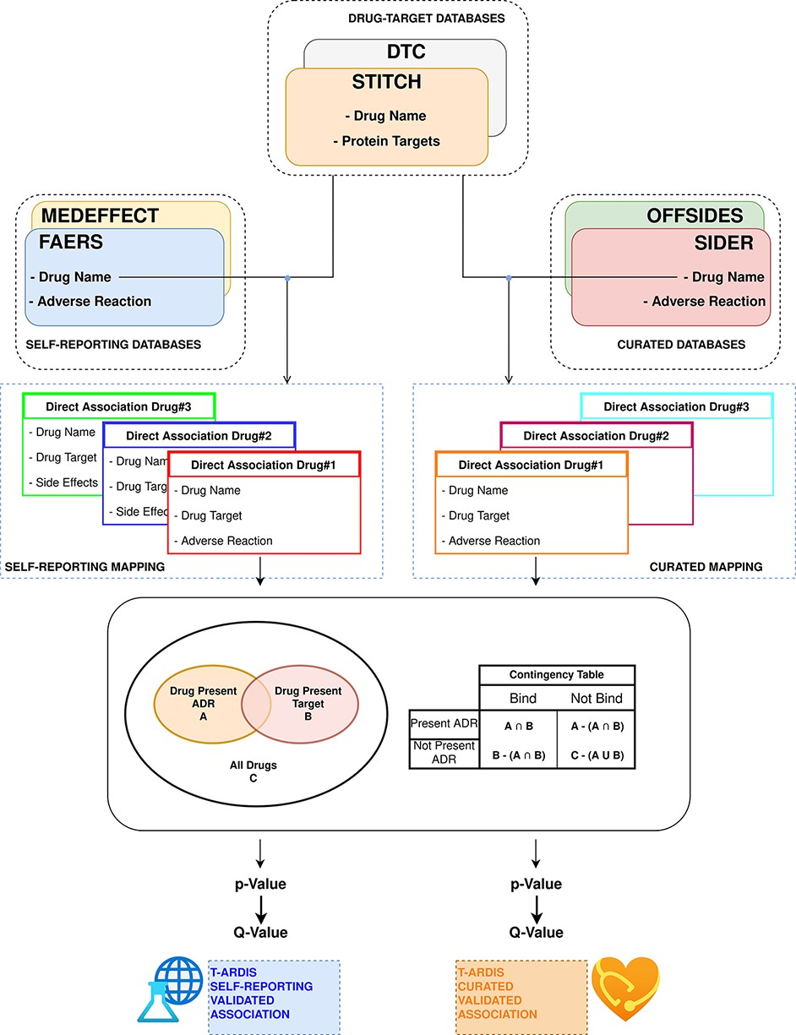
Figure 1. Workflow followed to combine and derive statistical associations between proteins and ADR. Drug–ADR and ...
Notes:
Figure 1. Workflow followed to combine and derive statistical associations between proteins and ADR. Drug–ADR and drug–target associations are retrieved from relevant databases. Subsequently, statistical association between proteins and ADRs is computed as described by Kuhn et al. (10).
Unless provided in the caption above, the following copyright applies to the content of this slide: © The Author(s) 2021. Published by Oxford University Press.This is an Open Access article distributed under the terms of the Creative Commons Attribution License (https://creativecommons.org/licenses/by/4.0/), which permits unrestricted reuse, distribution, and reproduction in any medium, provided the original work is properly cited.

Slide 2
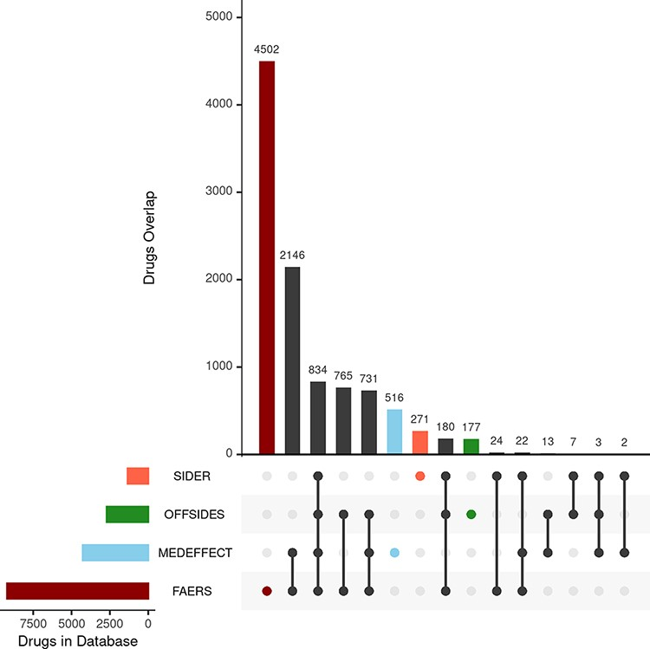
Figure 2. Upset plot showing the overlap between the different databases compiling drug–ADR associations. FAERS, ...
Notes:
Figure 2. Upset plot showing the overlap between the different databases compiling drug–ADR associations. FAERS, MEDEFFECT, OFFSIDES and SIDER represented as dark red, light blue, green and orange, respectively.
Unless provided in the caption above, the following copyright applies to the content of this slide: © The Author(s) 2021. Published by Oxford University Press.This is an Open Access article distributed under the terms of the Creative Commons Attribution License (https://creativecommons.org/licenses/by/4.0/), which permits unrestricted reuse, distribution, and reproduction in any medium, provided the original work is properly cited.

Slide 3
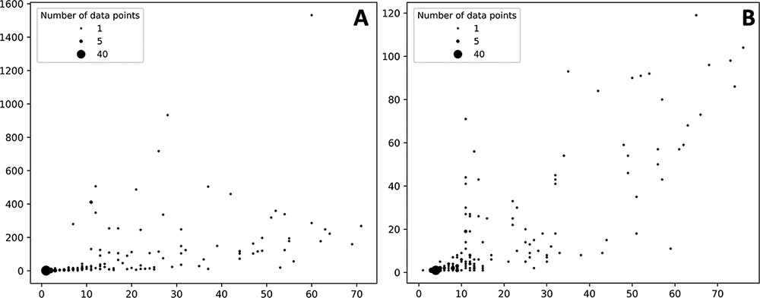
Figure 3. Bubble plots showing the number of drugs per protein (X axis) vs number of statistically significant ADR per ...
Notes:
Figure 3. Bubble plots showing the number of drugs per protein (X axis) vs number of statistically significant ADR per protein (Y axis). (A) Distribution of the self-reporting set; (B) distribution of the curate set. Refer to the ‘Material and methods’ section for the description of self-reporting and curated sets.
Unless provided in the caption above, the following copyright applies to the content of this slide: © The Author(s) 2021. Published by Oxford University Press.This is an Open Access article distributed under the terms of the Creative Commons Attribution License (https://creativecommons.org/licenses/by/4.0/), which permits unrestricted reuse, distribution, and reproduction in any medium, provided the original work is properly cited.

Slide 4
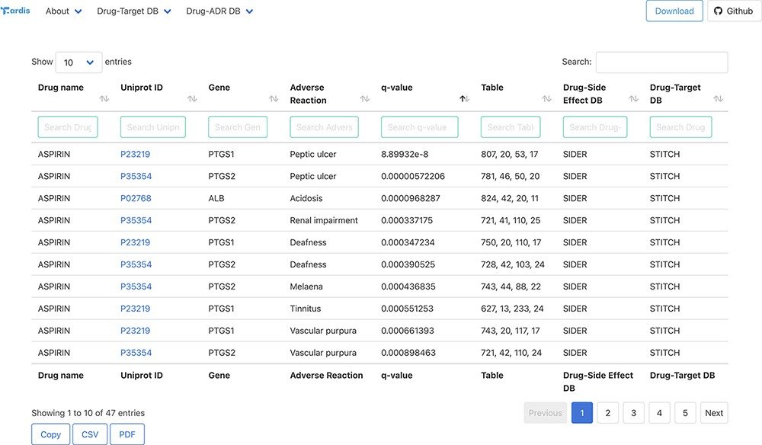
Figure 4. Snapshot of the result page example upon querying by drug ‘Aspirin’.
Notes:
Figure 4. Snapshot of the result page example upon querying by drug ‘Aspirin’.
Unless provided in the caption above, the following copyright applies to the content of this slide: © The Author(s) 2021. Published by Oxford University Press.This is an Open Access article distributed under the terms of the Creative Commons Attribution License (https://creativecommons.org/licenses/by/4.0/), which permits unrestricted reuse, distribution, and reproduction in any medium, provided the original work is properly cited.

