Slide 1
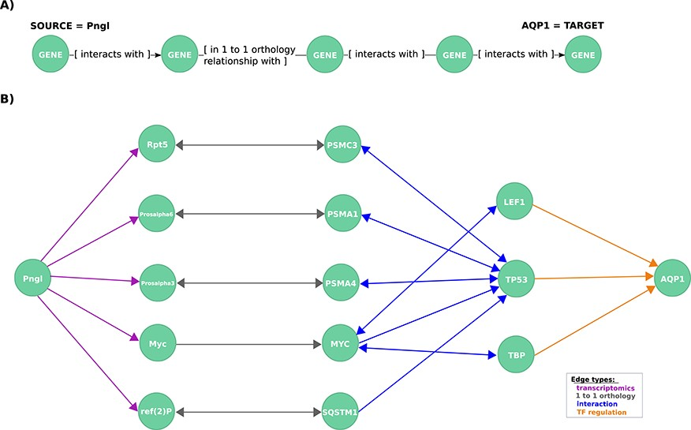
Figure 3 Exploration of mechanistic paths between NGLY1 and AQP1 based on the regulatory hypothesis. (A) First query ...
Notes:
Figure 3 Exploration of mechanistic paths between NGLY1 and AQP1 based on the regulatory hypothesis. (A) First query topology for the regulatory hypothesis. We defined a path topology based on gene pathways of length four linking the NGLY1 ortholog in Drosophila (Pngl) with the human AQP1 gene. The bridging nodes and edges were based on transcriptional regulatory relationships in both Drosophila and human, plus orthology relationships between human and fly genes. (B) Mechanistic hypotheses resulted from the first query.
Unless provided in the caption above, the following copyright applies to the content of this slide: © The Author(s) 2020. Published by Oxford University Press.This is an Open Access article distributed under the terms of the Creative Commons Attribution License (http://creativecommons.org/licenses/by/4.0/), which permits unrestricted reuse, distribution, and reproduction in any medium, provided the original work is properly cited.

