Slide 1
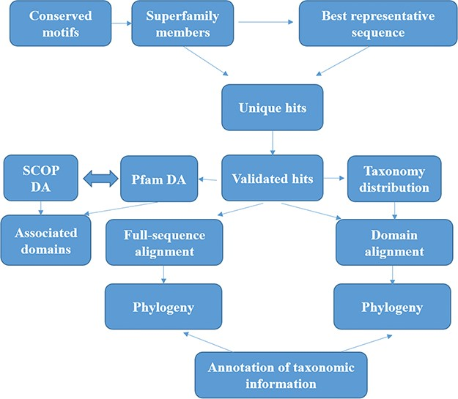
Figure 1 Workflow followed for GenDiS+. The sequence searches were carried out using BRS-MP approach for ...
Notes:
Figure 1 Workflow followed for GenDiS+. The sequence searches were carried out using BRS-MP approach for multi-membered superfamilies, as described in the Materials and Methods section. The hits were validated using a stringent validation using structure-based sequence alignments of superfamily members. From the validated hits, features like DA computation and phylogeny, domain and full-length alignment and phylogeny and conserved motifs were analysed and have been made available in the database.
Unless provided in the caption above, the following copyright applies to the content of this slide: © The Author(s) 2019. Published by Oxford University Press.This is an Open Access article distributed under the terms of the Creative Commons Attribution License (http://creativecommons.org/licenses/by/4.0/), which permits unrestricted reuse, distribution, and reproduction in any medium, provided the original work is properly cited.

