Slide 1
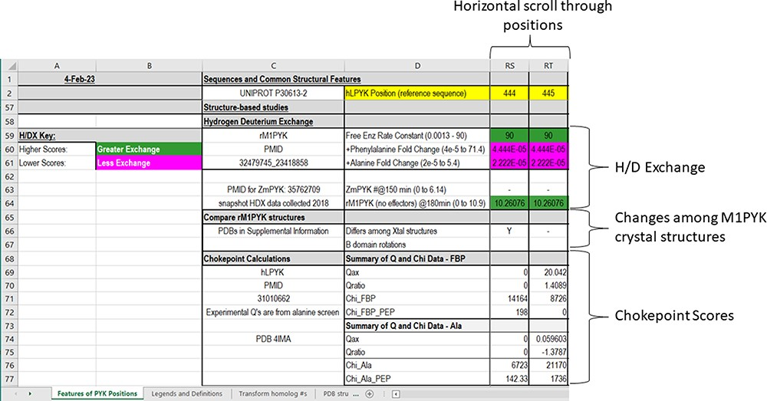
Figure 6. The bottom section of the ‘Features of PYK Positions’ worksheet in the PYK-SubstitutionOME workbook. Again, ...
Notes:
Figure 6. The bottom section of the ‘Features of PYK Positions’ worksheet in the PYK-SubstitutionOME workbook. Again, Rows 1 and 2 and Columns A–D are anchored to provide reference points. This section contains structural information, including H/DX data from both rM1PYK and ZmPYK, structural comparisons for M1PYK and chokepoint calculations for hLPYK. H/DX scores are color-coded to aid visual interpretation; color legends are in the left-most columns.
Unless provided in the caption above, the following copyright applies to the content of this slide: © The Author(s) 2023. Published by Oxford University Press.This is an Open Access article distributed under the terms of the Creative Commons Attribution License (https://creativecommons.org/licenses/by/4.0/), which permits unrestricted reuse, distribution, and reproduction in any medium, provided the original work is properly cited.

