Slide 1
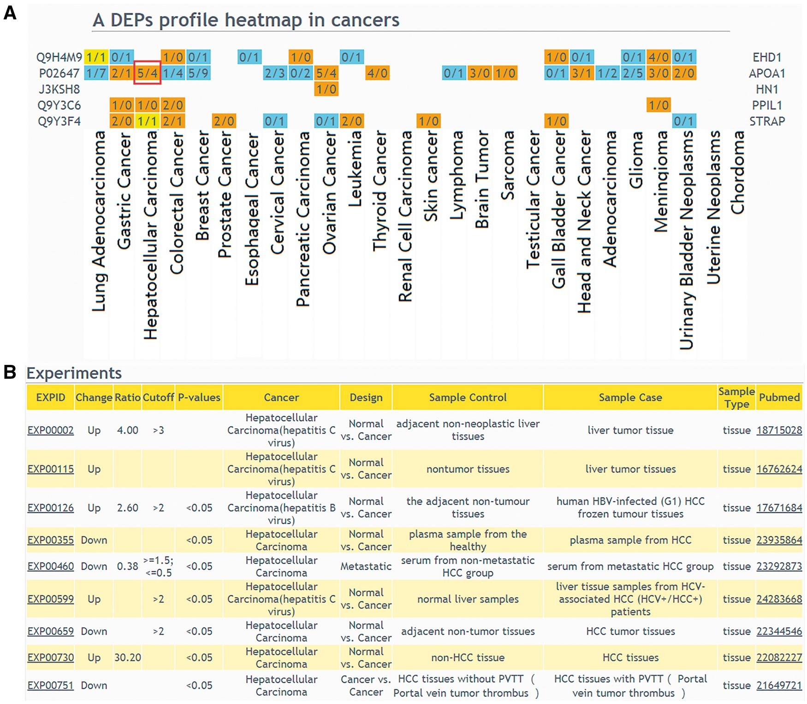
Figure 3. The result of ‘protein list’ query. (A) Users should select a design type of interested experiments first, ...
Notes:
Figure 3. The result of ‘protein list’ query. (A) Users should select a design type of interested experiments first, input protein IDs or names and then select cancers to draw a DEPs profile heatmap in cancers. If a queried protein is a DEP, the table cell will be displayed in color. Orange means that the experiments number identified this protein as up-regulated is more than the experiments number identified protein as down-regulated; blue means that the experiments number identified this protein as up-regulated is less than the experiments number identified protein as down-regulated; yellow means that the experiments number identified the protein as up-regulated is equal to the experiments number identified protein as down-regulated. (B) If the number of experiments in a specific cancer type is clicked, the detailed information of these DEPs can be displayed.
Unless provided in the caption above, the following copyright applies to the content of this slide: © The Author(s) 2018. Published by Oxford University Press.This is an Open Access article distributed under the terms of the Creative Commons Attribution License (http://creativecommons.org/licenses/by/4.0/), which permits unrestricted reuse, distribution, and reproduction in any medium, provided the original work is properly cited.

