Slide 1
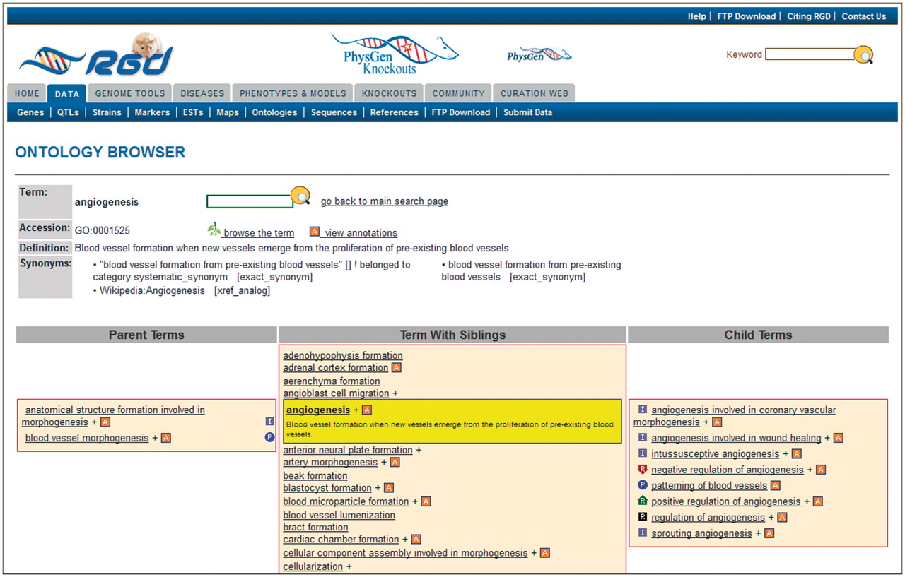
Figure 4. New RGD ontology browser. Terms are displayed in a driller format with each term being selectable such that ...
Notes:
Figure 4. New RGD ontology browser. Terms are displayed in a driller format with each term being selectable such that the selected term is highlighted and placed in the center column with all of its sibling terms. The selected term’s definition is shown both highlighted under the term in the center column and also at the top of the page. All parent terms of the selected term are listed in the left column and child terms of the selected term are listed in the right column. For any term that has annotations to it in RGD, the ‘A’ icon is a link to an ontology report page listing all RGD annotations to that term.
Unless provided in the caption above, the following copyright applies to the content of this slide: © The Author(s) 2012. Published by Oxford University Press.This is an Open Access article distributed under the terms of the Creative Commons Attribution Non-Commercial License (http://creativecommons.org/licenses/by-nc/3.0), which permits unrestricted non-commercial use, distribution, and reproduction in any medium, provided the original work is properly cited.

