Slide 1
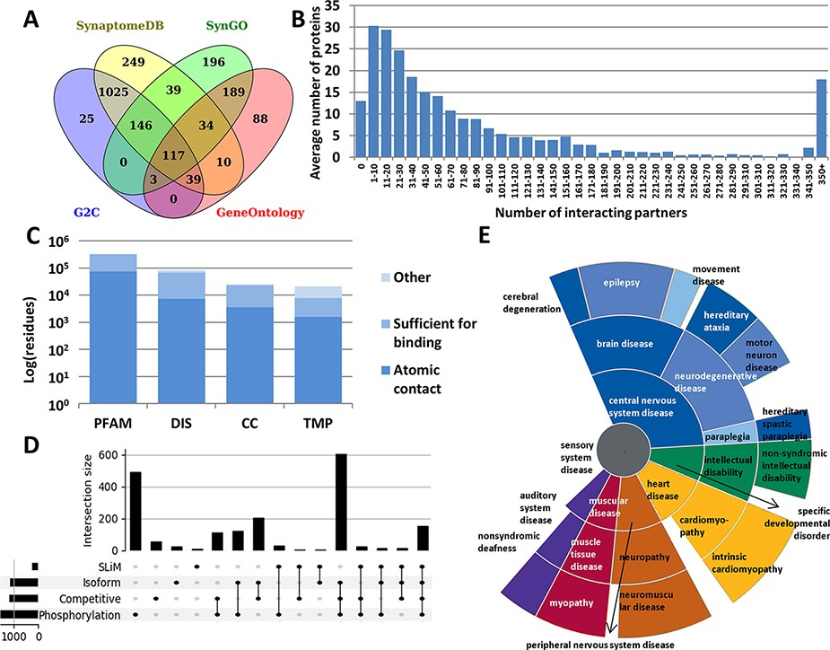
Figure 1. Summary statistics of PSINDB database: (A) Number of postsynaptic proteins from each source database and ...
Notes:
Figure 1. Summary statistics of PSINDB database: (A) Number of postsynaptic proteins from each source database and their overlaps. (B) Distribution of interacting partners of postsynaptic proteins. (C) Ratio of residues in different structural binding regions, colored by the level of information available about the binding residue (PFAM: belonging to protein families identified by Pfam; DIS: Disordered; CC: Coiled-coil; TMP: Transmembrane Protein). (D) Distribution of regulatory mechanisms in PS proteins (SLiM: Short Linear Motif). (E) Distribution of diseases associated with PS proteins. The more general the term, the closer it is to the center.
Unless provided in the caption above, the following copyright applies to the content of this slide: © The Author(s) 2022. Published by Oxford University Press.This is an Open Access article distributed under the terms of the Creative Commons Attribution License (https://creativecommons.org/licenses/by/4.0/), which permits unrestricted reuse, distribution, and reproduction in any medium, provided the original work is properly cited.

