Slide 1
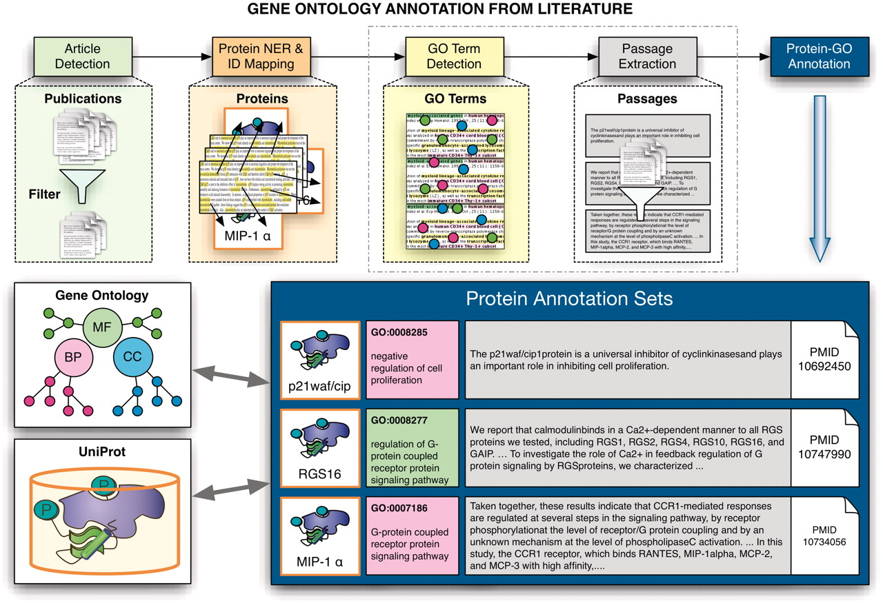
Figure 3. Schematic overview of the extraction of GO annotations from the literature. The process illustrates the ...
Notes:
Figure 3. Schematic overview of the extraction of GO annotations from the literature. The process illustrates the individual steps of the annotation process, covering the initial selection of relevant documents for GO annotation of proteins, identification of proteins and their corresponding database identifiers followed by the extraction of associations to GO terms and the retrieval of evidence sentences/passages. The participating teams had to provide the evidence passages for a given document–protein–GO term triplet for one subtask, and to actually detect GO–protein associations (together with evidence passages) for the other subtask.
Unless provided in the caption above, the following copyright applies to the content of this slide: © The Author(s) 2012. Published by Oxford University Press.This is an Open Access article distributed under the terms of the Creative Commons Attribution Non-Commercial License (http://creativecommons.org/licenses/by-nc/3.0), which permits unrestricted non-commercial use, distribution, and reproduction in any medium, provided the original work is properly cited.

