Slide 1
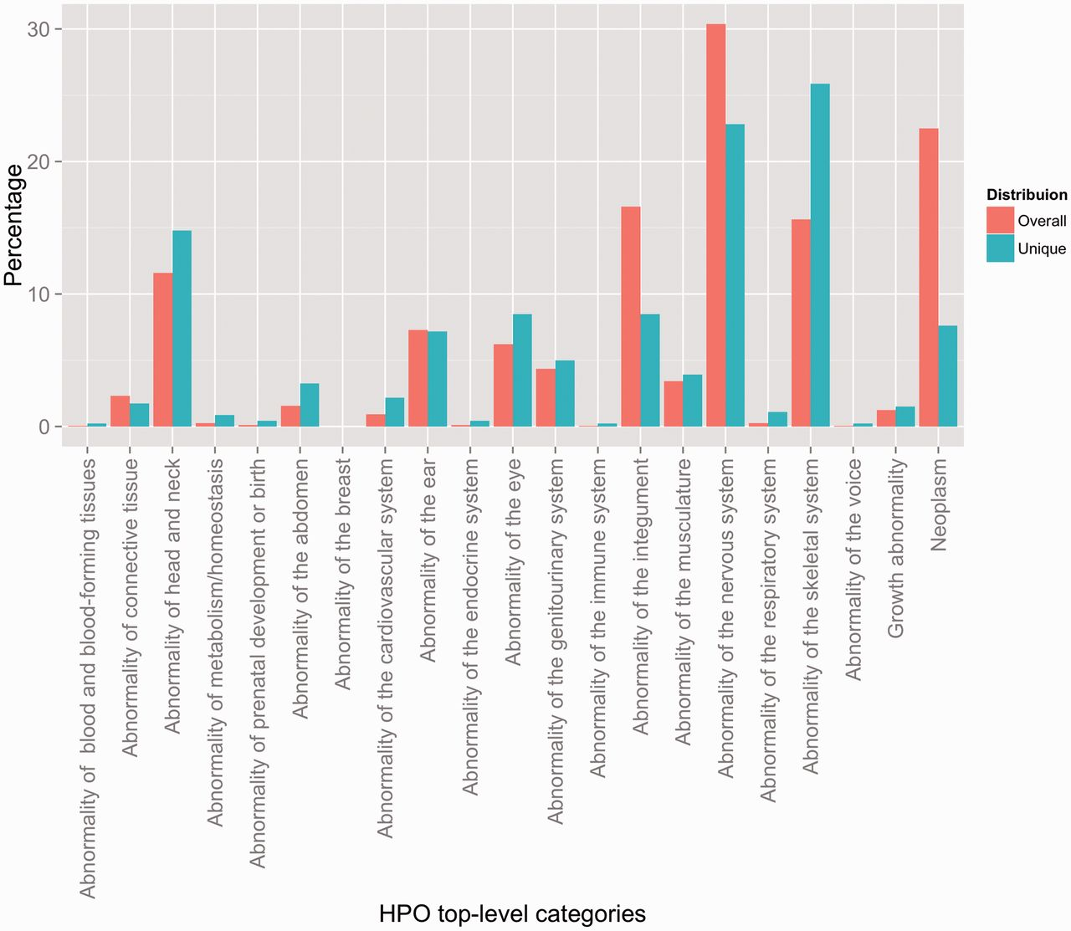
Figure 2. Distribution of HPO annotations according to the top-level HPO categories. Two distributions are shown: an ...
Notes:
Figure 2. Distribution of HPO annotations according to the top-level HPO categories. Two distributions are shown: an overall distribution that accounts for duplicate concept annotations (i.e. every instance of an annotation is counted), and a unique distribution that shows the counts of the unique concept annotations (i.e. every concept is counted a single time, indifferently of how many annotations exist in the corpus).
Unless provided in the caption above, the following copyright applies to the content of this slide: © The Author(s) 2015. Published by Oxford University Press.This is an Open Access article distributed under the terms of the Creative Commons Attribution License (http://creativecommons.org/licenses/by/4.0/), which permits unrestricted reuse, distribution, and reproduction in any medium, provided the original work is properly cited.

