Slide 1
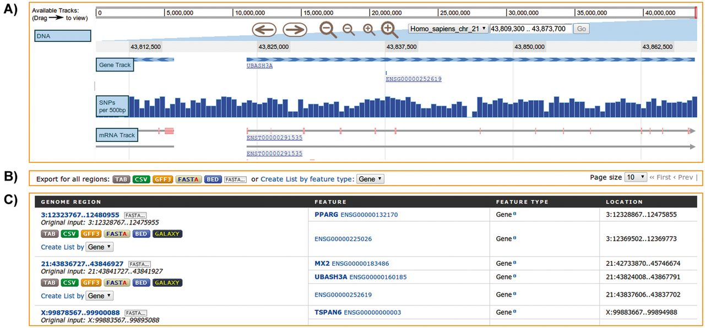
Figure 6. Regions Search. Analysis of genomic intervals using metabolicMine’s regions search, showing gene feature ...
Notes:
Figure 6. Regions Search. Analysis of genomic intervals using metabolicMine’s regions search, showing gene feature results from an uploaded list of genomic regions. (A) The embedded interactive genome browser allows a visual exploration of the results. (B) The results can be exported in a range of formats, including TAB, CSV, GFF, BED and FASTA. (C) The table displays results hyperlinked to individual report pages.
Unless provided in the caption above, the following copyright applies to the content of this slide: © Crown copyright 2013.

