Slide 1
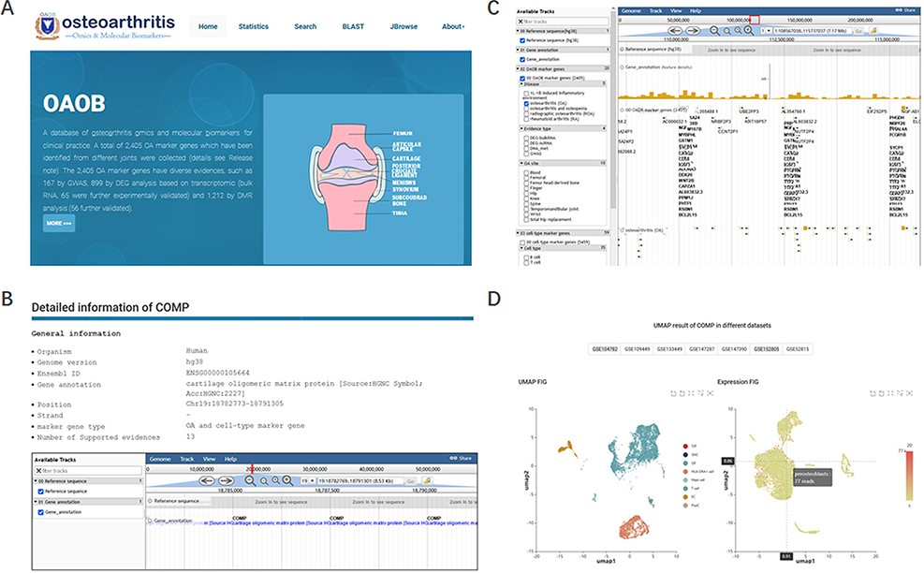
Figure 2. Display of the homepage and function modules of OAOB database. (A) Web homepage of the OAOB database, showing ...
Notes:
Figure 2. Display of the homepage and function modules of OAOB database. (A) Web homepage of the OAOB database, showing four main functional modules: Statistics, Search, Basic Local Alignment Search Tool (BLAST) and Jbrowse. (B) Using the marker gene cartilage oligomeric matrix protein (COMP) as an example to show all different kinds of information provided. (C) Jbrowse modules of OAOB database. (D) An example showing the marker gene COMP that was supported by scRNA-seq analysis.
Unless provided in the caption above, the following copyright applies to the content of this slide: © The Author(s) 2022. Published by Oxford University Press.This is an Open Access article distributed under the terms of the Creative Commons Attribution-NonCommercial License (https://creativecommons.org/licenses/by-nc/4.0/), which permits non-commercial re-use, distribution, and reproduction in any medium, provided the original work is properly cited. For commercial re-use, please contact journals.permissions@oup.com

