Slide 1
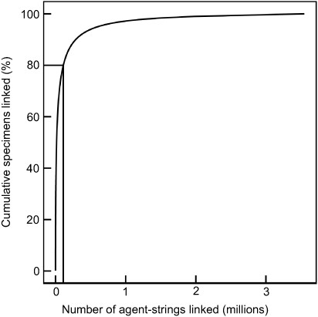
Figure 1. Cumulative percent of specimens associated with rank order of raw collector name strings. Collector name ...
Notes:
Figure 1. Cumulative percent of specimens associated with rank order of raw collector name strings. Collector name strings were parsed using the dwc_agent ruby gem, https://rubygems.org/gems/dwc_agent from 199M occurrence records downloaded from the Global Biodiversity Information Facility, https://doi.org/10.15468/dl.apmkx0 and are not reconciled or resolved to authoritative sources.
Unless provided in the caption above, the following copyright applies to the content of this slide: © The Author(s) 2020. Published by Oxford University Press.This is an Open Access article distributed under the terms of the Creative Commons Attribution License (http://creativecommons.org/licenses/by/4.0/), which permits unrestricted reuse, distribution, and reproduction in any medium, provided the original work is properly cited.

