Slide 1
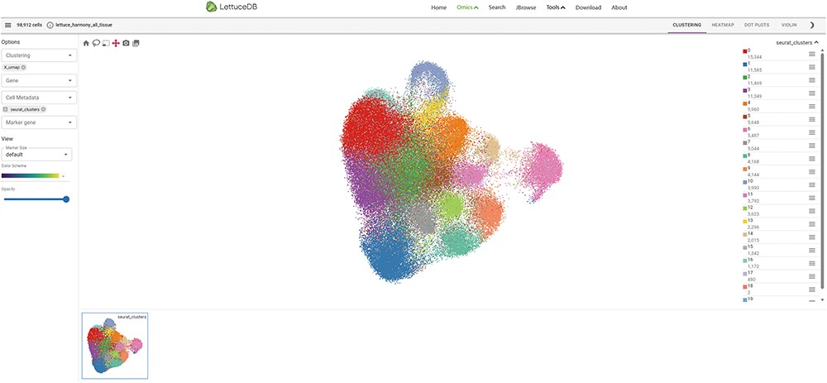
Figure 9. Webpage of the Spatial Omics module, including the main canvas in the center, toolbar on the top, section ...
Notes:
Figure 9. Webpage of the Spatial Omics module, including the main canvas in the center, toolbar on the top, section selector on left, sidebar on right and gallery at the bottom.
Unless provided in the caption above, the following copyright applies to the content of this slide: © The Author(s) 2024. Published by Oxford University Press.This is an Open Access article distributed under the terms of the Creative Commons Attribution License (https://creativecommons.org/licenses/by/4.0/), which permits unrestricted reuse, distribution, and reproduction in any medium, provided the original work is properly cited.

