Slide 1
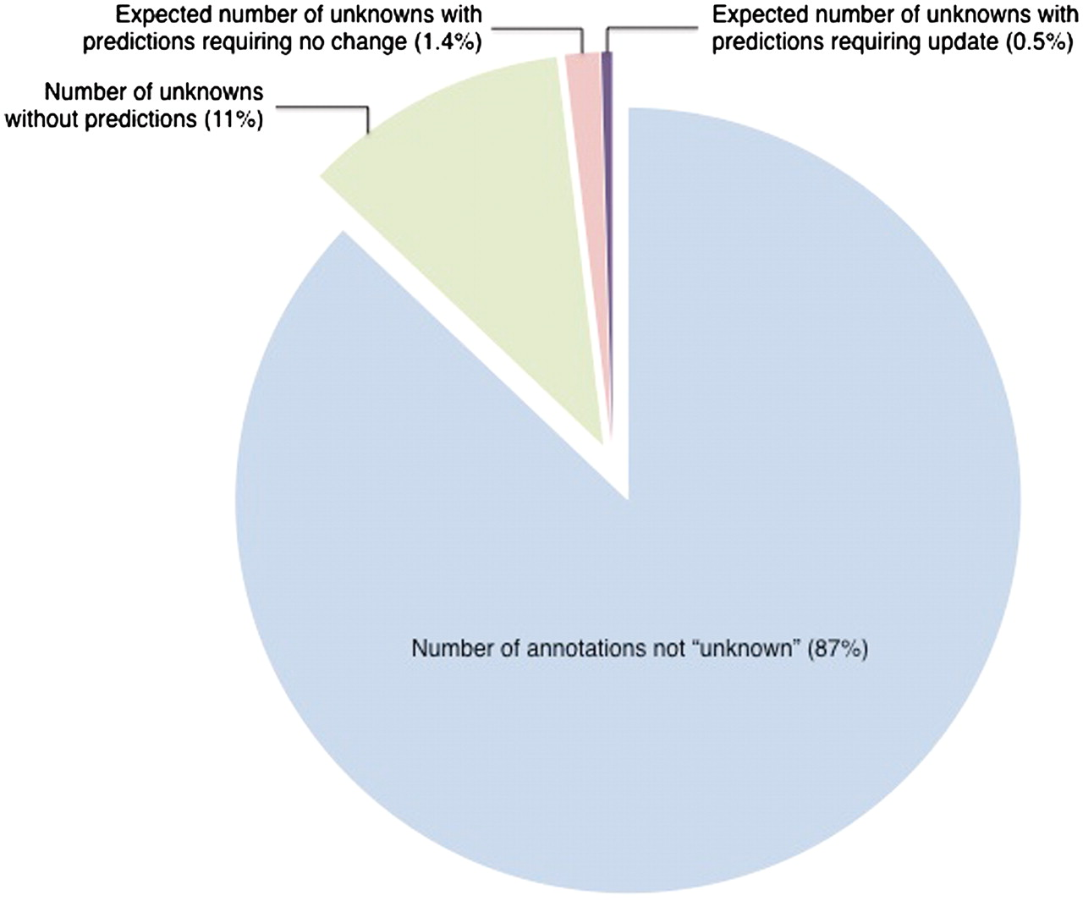
Figure 1. Estimated number of ‘unknown’ annotations that could be updated by comparison to InterPro-based computational ...
Notes:
Figure 1. Estimated number of ‘unknown’ annotations that could be updated by comparison to InterPro-based computational predictions. Out of 31 977 literature-based GO annotations, 4129 annotations, representing 13% of all annotations, are to the root terms ‘molecular_function’, ‘biological_process’, ‘cellular_component’ (referred to as ‘unknown’). Based on a review of a representative set, only 145 ‘unknown’ annotations are projected to need review. This represents 0.5% of the entire set of annotations. All data are from October 2009.
Unless provided in the caption above, the following copyright applies to the content of this slide: © The Author(s) 2011. Published by Oxford University Press.This is Open Access article distributed under the terms of the Creative Commons Attribution Non-Commercial License (http://creativecommons.org/licenses/by-nc/2.5), which permits unrestricted non-commercial use, distribution, and reproduction in any medium, provided the original work is properly cited.

