Slide 1
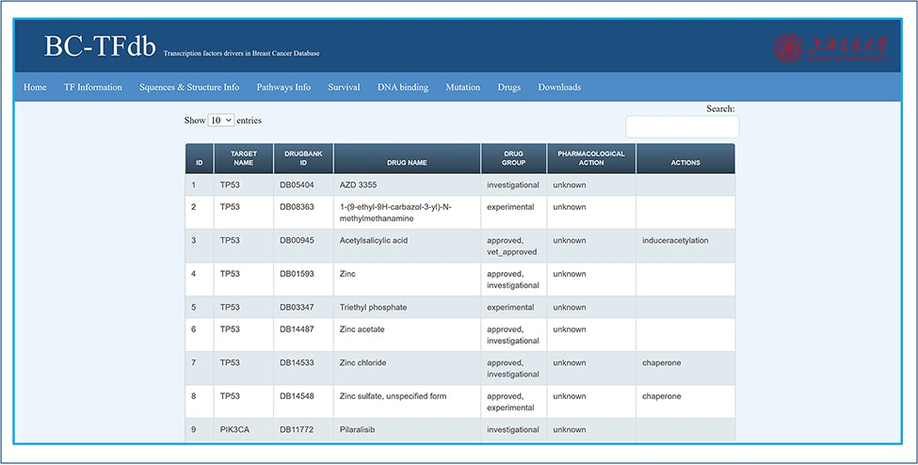
Figure 8. Representative image of the Drugs tab with various headers representing each feature.
Notes:
Figure 8. Representative image of the Drugs tab with various headers representing each feature.
Unless provided in the caption above, the following copyright applies to the content of this slide: © Crown copyright 2021.This Open Access article contains public sector information licensed under the Open Government Licence v3.0 (http://www.nationalarchives.gov.uk/doc/open-government-licence/version/3/).

