Slide 1
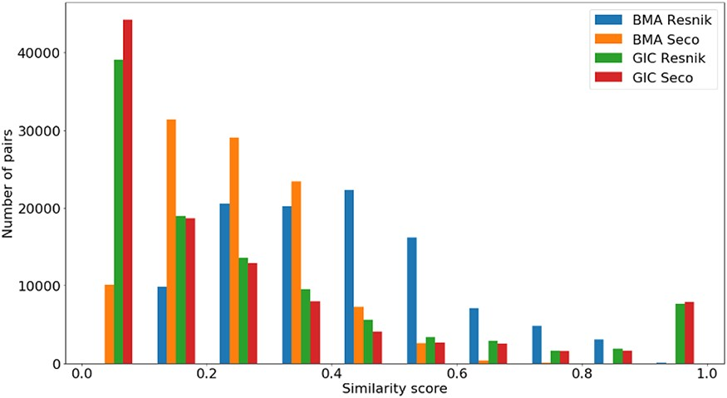
Figure 5. Distribution of all semantic similarity metrics ...
Notes:
Figure 5. Distribution of all semantic similarity metrics (${\rm{BM}}{{\rm{A}}_{{\rm{Resnik}}}},{\rm{BM}}{{\rm{A}}_{{\rm{Seco}}}}, simGI{C_{{\rm{Resnik}}}}$and $simGI{C_{Seco}}$) values across all species’ protein pairs in the protein family data sets.
Unless provided in the caption above, the following copyright applies to the content of this slide: © The Author(s) 2020. Published by Oxford University Press.This is an Open Access article distributed under the terms of the Creative Commons Attribution License (http://creativecommons.org/licenses/by/4.0/), which permits unrestricted reuse, distribution, and reproduction in any medium, provided the original work is properly cited.

