Slide 1
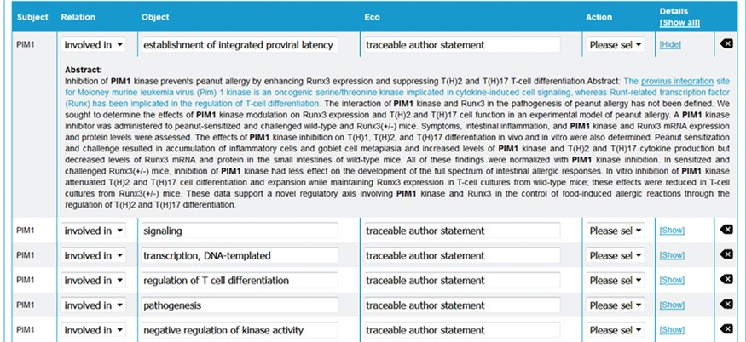
Figure 3 neXtA₅ user interface for curation. From the abstract of an article, neXtA₅ extracts ...
Notes:
Figure 3 neXtA5 user interface for curation. From the abstract of an article, neXtA5 extracts relevant concepts and displays a list of potential annotations. Here, the annotations related to PIM1 for the BPs and extracted from the abstract of (32) are shown.
Unless provided in the caption above, the following copyright applies to the content of this slide: © The Author(s) 2018. Published by Oxford University Press.This is an Open Access article distributed under the terms of the Creative Commons Attribution License (http://creativecommons.org/licenses/by/4.0/), which permits unrestricted reuse, distribution, and reproduction in any medium, provided the original work is properly cited.

