Slide 1
Figure 1. Data sources and analysis pipeline used to build the database.
Notes:
Figure 1. Data sources and analysis pipeline used to build the database.
Unless provided in the caption above, the following copyright applies to the content of this slide: © The Author(s) 2020. Published by Oxford University Press.This is an Open Access article distributed under the terms of the Creative Commons Attribution License (http://creativecommons.org/licenses/by/4.0/), which permits unrestricted reuse, distribution, and reproduction in any medium, provided the original work is properly cited.

Slide 2
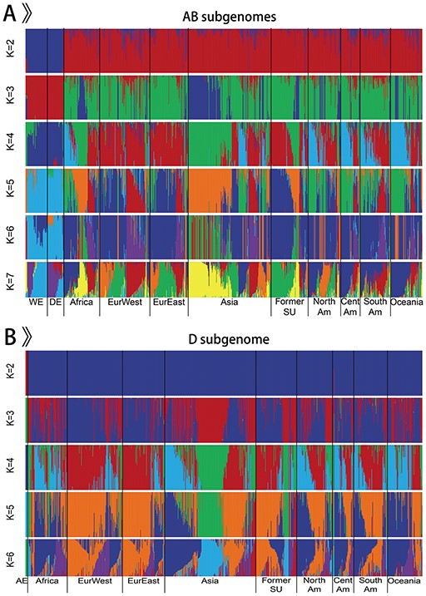
Figure 2. Population structure of 968 accessions.
Notes:
Figure 2. Population structure of 968 accessions. A. Population structure of 963 emmer wheat and bread wheat accessions on AB subgenomes. B. Population structure of 875 Ae. tauschii and bread wheat accessions on D subgenome.
Unless provided in the caption above, the following copyright applies to the content of this slide: © The Author(s) 2020. Published by Oxford University Press.This is an Open Access article distributed under the terms of the Creative Commons Attribution License (http://creativecommons.org/licenses/by/4.0/), which permits unrestricted reuse, distribution, and reproduction in any medium, provided the original work is properly cited.

Slide 3
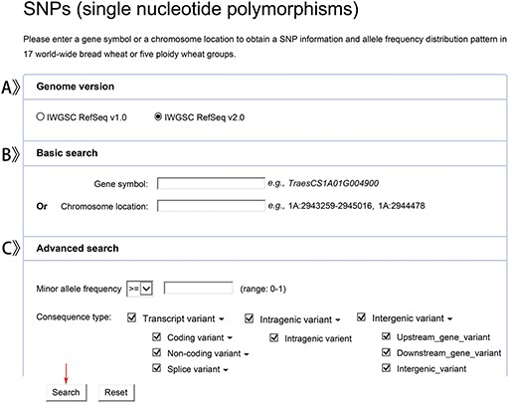
Figure 3. Screenshots of a SNP data search.
Notes:
Figure 3. Screenshots of a SNP data search. A. Genome version items. B. Basic search items. C. Advanced search items.
Unless provided in the caption above, the following copyright applies to the content of this slide: © The Author(s) 2020. Published by Oxford University Press.This is an Open Access article distributed under the terms of the Creative Commons Attribution License (http://creativecommons.org/licenses/by/4.0/), which permits unrestricted reuse, distribution, and reproduction in any medium, provided the original work is properly cited.

Slide 4
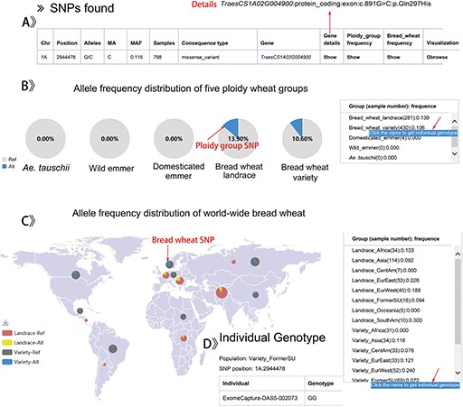
Figure 4. The result display by searching a SNP data for example.
Notes:
Figure 4. The result display by searching a SNP data for example. A. Detailed annotation of a SNP in TraesCS1A02G004900 gene. B. The pie-chart of allele frequency distribution for five ploidy wheat groups. C. Display format of the allele frequency for the SNP of 17 worldwide bread wheat groups. D. The individual genotypes in the group of Variety_FormerSU.
Unless provided in the caption above, the following copyright applies to the content of this slide: © The Author(s) 2020. Published by Oxford University Press.This is an Open Access article distributed under the terms of the Creative Commons Attribution License (http://creativecommons.org/licenses/by/4.0/), which permits unrestricted reuse, distribution, and reproduction in any medium, provided the original work is properly cited.

Slide 5
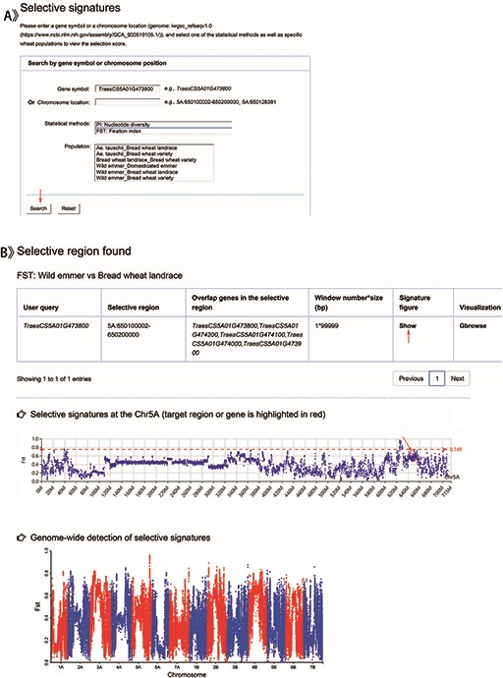
Figure 5. Screenshots of a search for genomic selection data and the result display for example.
Notes:
Figure 5. Screenshots of a search for genomic selection data and the result display for example. A. Search items including gene symbol, chromosome location, one of the statistical tests (Pi and FST) and specific ploidy wheat groups. B. Detailed annotation for the target gene or region in the variant grid and the corresponding selective signatures at the chromosome and whole-genome levels, respectively. An example of selective signal Fst of TraesS5A01G473800 gene between wild emmer and bread wheat landrace.
Unless provided in the caption above, the following copyright applies to the content of this slide: © The Author(s) 2020. Published by Oxford University Press.This is an Open Access article distributed under the terms of the Creative Commons Attribution License (http://creativecommons.org/licenses/by/4.0/), which permits unrestricted reuse, distribution, and reproduction in any medium, provided the original work is properly cited.

Slide 6
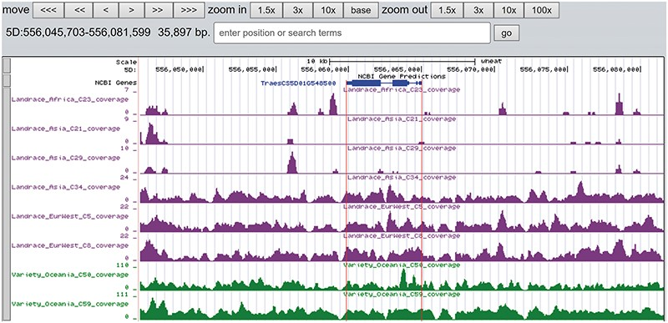
Figure 6. The read coverage depth on the region of gene TraesCS5D01G548500 in eight bread wheat accessions. The gene is ...
Notes:
Figure 6. The read coverage depth on the region of gene TraesCS5D01G548500 in eight bread wheat accessions. The gene is absent in three landrace (C21, C23 and C29) as indicated by the few reads alignment, while it is present in the other five accessions.
Unless provided in the caption above, the following copyright applies to the content of this slide: © The Author(s) 2020. Published by Oxford University Press.This is an Open Access article distributed under the terms of the Creative Commons Attribution License (http://creativecommons.org/licenses/by/4.0/), which permits unrestricted reuse, distribution, and reproduction in any medium, provided the original work is properly cited.

Slide 7
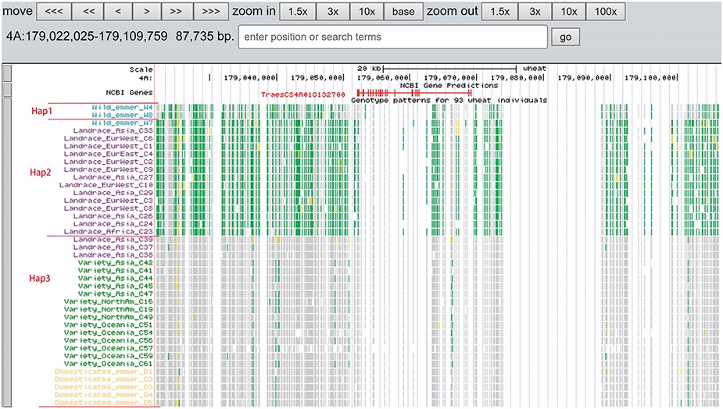
Figure 7. Three haplotypes (Hap1, Hap2 and Hap3) for gene TraesCS4A01G132700 region among wild emmer, domesticated ...
Notes:
Figure 7. Three haplotypes (Hap1, Hap2 and Hap3) for gene TraesCS4A01G132700 region among wild emmer, domesticated emmer, landrace and variety based on the genotype pattern with homozygous reference in gray, heterozygous variant in yellow and homozygous variant in green.
Unless provided in the caption above, the following copyright applies to the content of this slide: © The Author(s) 2020. Published by Oxford University Press.This is an Open Access article distributed under the terms of the Creative Commons Attribution License (http://creativecommons.org/licenses/by/4.0/), which permits unrestricted reuse, distribution, and reproduction in any medium, provided the original work is properly cited.

Slide 8
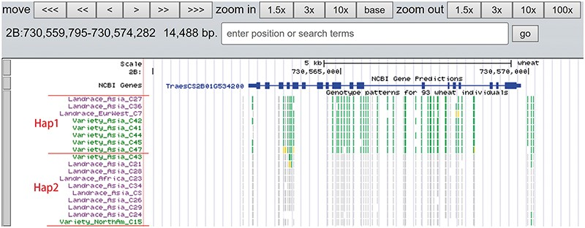
Figure 8. Two haplotypes (Hap1 and Hap2) for gene TraesCS2B01G534200 region among bread wheat based on the genotype ...
Notes:
Figure 8. Two haplotypes (Hap1 and Hap2) for gene TraesCS2B01G534200 region among bread wheat based on the genotype pattern with homozygous reference in gray, heterozygous variant in yellow and homozygous variant in green.
Unless provided in the caption above, the following copyright applies to the content of this slide: © The Author(s) 2020. Published by Oxford University Press.This is an Open Access article distributed under the terms of the Creative Commons Attribution License (http://creativecommons.org/licenses/by/4.0/), which permits unrestricted reuse, distribution, and reproduction in any medium, provided the original work is properly cited.

Slide 9
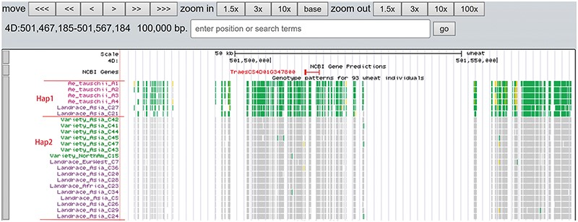
Figure 9. Two haplotypes (Hap1 and Hap2) for gene TraesCS4D01G347800 region among Ae. tauschii, landrace and variety ...
Notes:
Figure 9. Two haplotypes (Hap1 and Hap2) for gene TraesCS4D01G347800 region among Ae. tauschii, landrace and variety based on the genotype pattern with homozygous reference in gray, heterozygous variant in yellow and homozygous variant in green.
Unless provided in the caption above, the following copyright applies to the content of this slide: © The Author(s) 2020. Published by Oxford University Press.This is an Open Access article distributed under the terms of the Creative Commons Attribution License (http://creativecommons.org/licenses/by/4.0/), which permits unrestricted reuse, distribution, and reproduction in any medium, provided the original work is properly cited.

