Slide 1
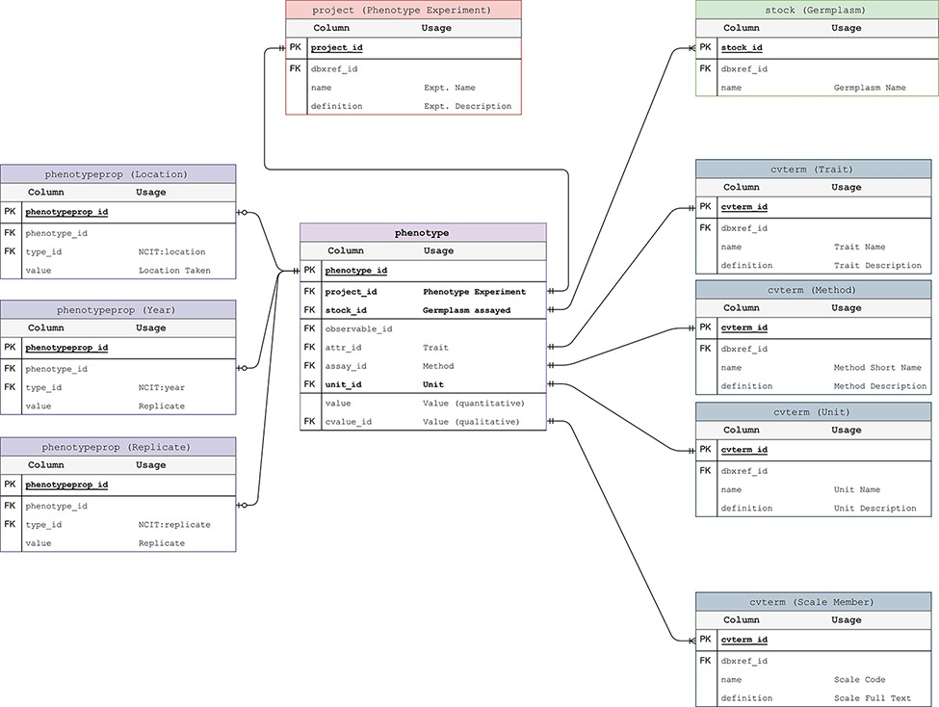
Figure 3. Phenotypic Data Model. The entity–relationship diagram describes the relevant sections of the Chado schema ...
Notes:
Figure 3. Phenotypic Data Model. The entity–relationship diagram describes the relevant sections of the Chado schema for storage of phenotypic data. This data model adheres to the standard Chado schema with the addition of stock, project and unit foreign keys to the phenotype table. The change is backward compatible but critical in that it allows us to store the trait-method-unit tuple in the phenotype table for each phenotypic data point.
Unless provided in the caption above, the following copyright applies to the content of this slide: © The Author(s) 2021. Published by Oxford University Press.This is an Open Access article distributed under the terms of the Creative Commons Attribution License (http://creativecommons.org/licenses/by/4.0/), which permits unrestricted reuse, distribution, and reproduction in any medium, provided the original work is properly cited.

