Slide 1
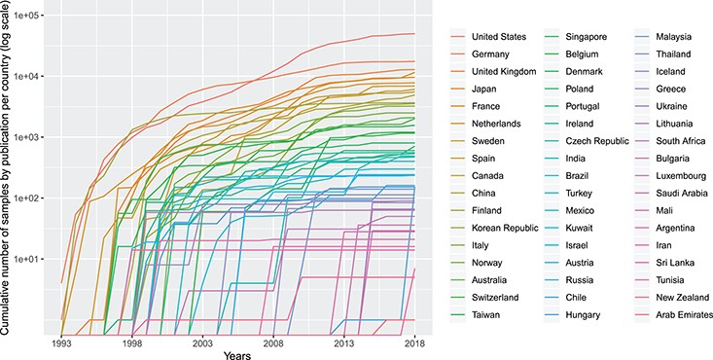
Figure 2 Cumulative number (in logarithmic scale) of genomic array samples (CCGH, ACGH, WES, WGS) contained in 3240 ...
Notes:
Figure 2 Cumulative number (in logarithmic scale) of genomic array samples (CCGH, ACGH, WES, WGS) contained in 3240 publications registered in the Progenetix database, split by their associated country, from 1993 to 2019 (publication year).
Unless provided in the caption above, the following copyright applies to the content of this slide: © The Author(s) 2020. Published by Oxford University Press.This is an Open Access article distributed under the terms of the Creative Commons Attribution License (http://creativecommons.org/licenses/by/4.0/), which permits unrestricted reuse, distribution, and reproduction in any medium, provided the original work is properly cited.

