Slide 1
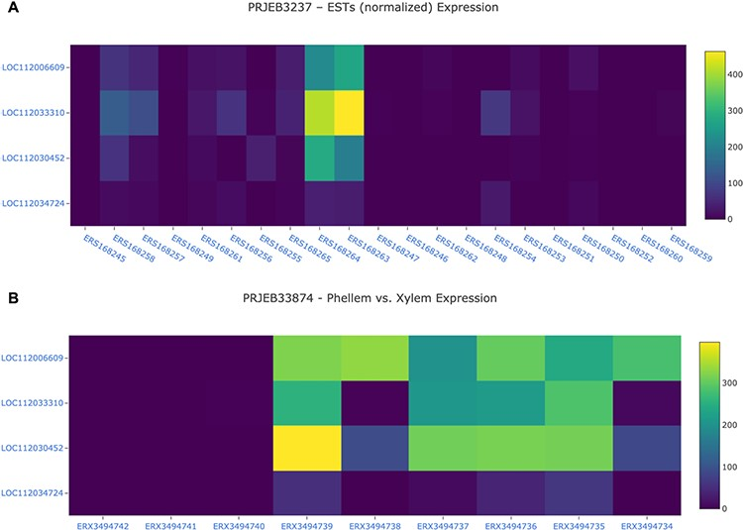
Figure 8. Gene expression analysis for the cork oak MYB39 (LOC112034724) and MYB92 (LOC112033310) orthologues, and two ...
Notes:
Figure 8. Gene expression analysis for the cork oak MYB39 (LOC112034724) and MYB92 (LOC112033310) orthologues, and two closely related MYB genes (LOC112030452 and LOC112006609) in different BioSamples included in BioProjects PRJEB3237 (A) and PRJEB33874 (B). These BioProjects were selected since they represent different cork oak tissues. BioSamples ERS168264, ERS168263 (upper panel), and ERX3494734 to ERX3494739 were obtained from developing phellem (or cork). BioSample names are hyperlinks to retrieve corresponding metadata.
Unless provided in the caption above, the following copyright applies to the content of this slide: © The Author(s) 2020. Published by Oxford University Press.This is an Open Access article distributed under the terms of the Creative Commons Attribution License (http://creativecommons.org/licenses/by/4.0/), which permits unrestricted reuse, distribution, and reproduction in any medium, provided the original work is properly cited.

