Slide 1
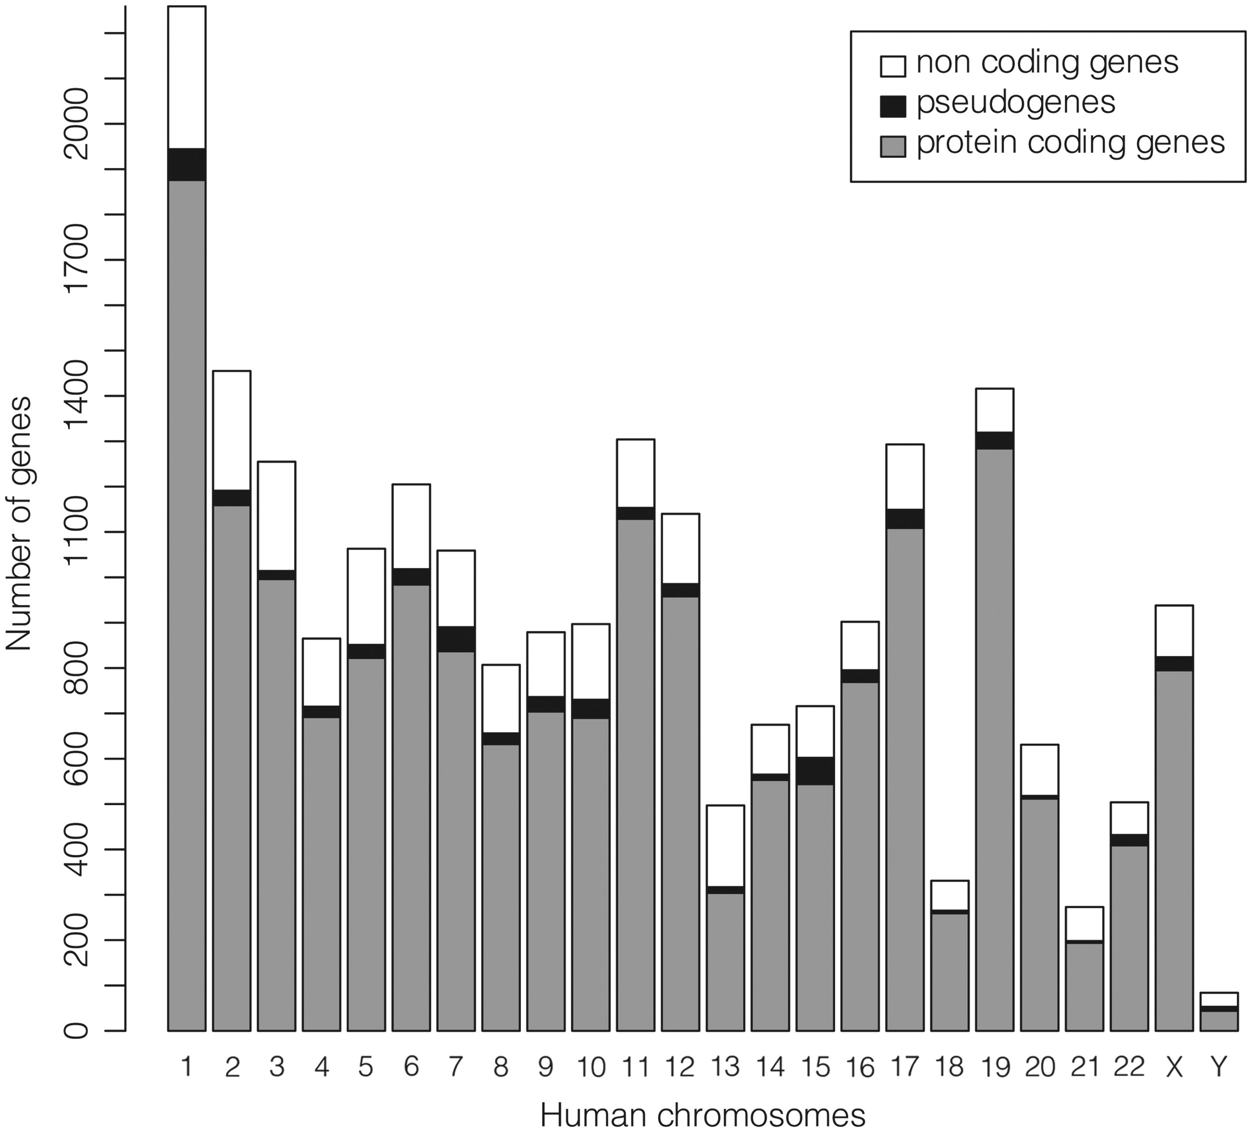
Figure 2. Number of ‘REVIEWED’ or ‘VALIDATED’ genes with at least one ‘REVIEWED’ or ‘VALIDATED’ transcript in GeneBase ...
Notes:
Figure 2. Number of ‘REVIEWED’ or ‘VALIDATED’ genes with at least one ‘REVIEWED’ or ‘VALIDATED’ transcript in GeneBase 1.1 Human (genes not in current annotation release are excluded) divided in protein-coding genes, pseudogenes and non-coding genes (which include genes for ribosomal RNAs, small nucleolar RNAs, small nuclear RNAs and non-coding RNAs) for each human chromosome. See Table 1 and Supplementary Table S2 for more details.
Unless provided in the caption above, the following copyright applies to the content of this slide: © The Author(s) 2016. Published by Oxford University Press.This is an Open Access article distributed under the terms of the Creative Commons Attribution License (http://creativecommons.org/licenses/by/4.0/), which permits unrestricted reuse, distribution, and reproduction in any medium, provided the original work is properly cited.

