Slide 1
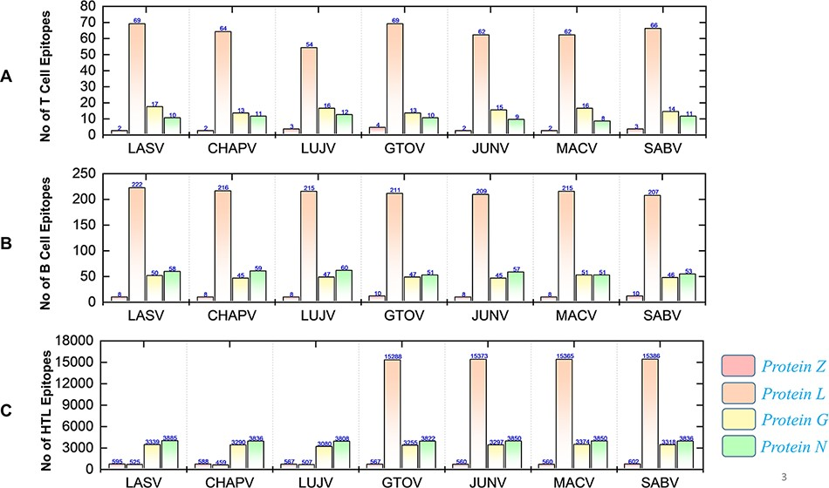
Figure 4. Demonstrates the total identified number of classified immune epitopes for each specific protein; (A) ...
Notes:
Figure 4. Demonstrates the total identified number of classified immune epitopes for each specific protein; (A) represents the number of specified T-cell epitopes, (B) represents the number of B-cell epitopes and (C) represents the number of HTL epitopes predicted for each protein for the seven mammarena species, respectively.
Unless provided in the caption above, the following copyright applies to the content of this slide: © The Author(s) 2021. Published by Oxford University Press.This is an Open Access article distributed under the terms of the Creative Commons Attribution License (https://creativecommons.org/licenses/by/4.0/), which permits unrestricted reuse, distribution, and reproduction in any medium, provided the original work is properly cited.

