Slide 1
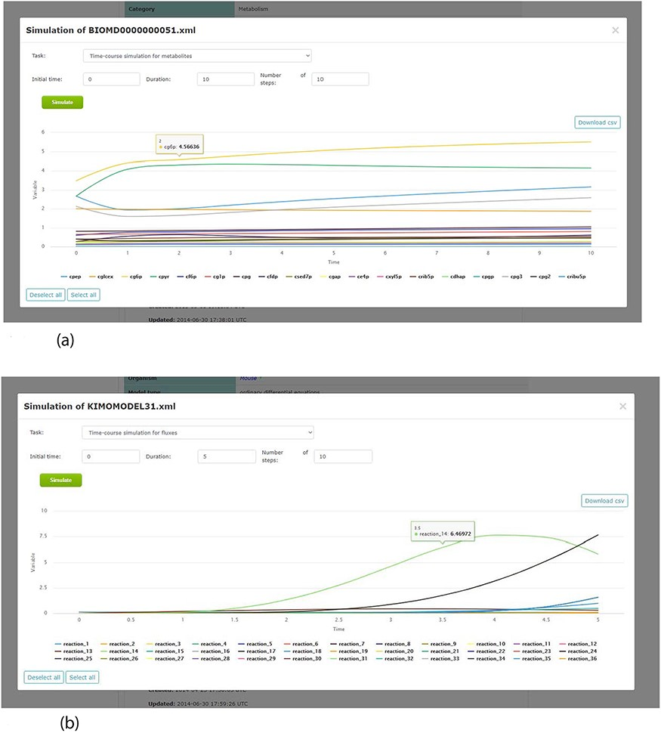
Figure 7. Screenshots of the simulation web interface for two different associated models stored in KiMoSys. The CSV ...
Notes:
Figure 7. Screenshots of the simulation web interface for two different associated models stored in KiMoSys. The CSV file is available to download the simulated data. (a) Example of metabolites time-course simulation with the Model EntryID 13. (b) Time profiles for the reaction fluxes simulation obtained with the Model EntryID 31.
Unless provided in the caption above, the following copyright applies to the content of this slide: © The Author(s) 2020. Published by Oxford University Press.This is an Open Access article distributed under the terms of the Creative Commons Attribution License (http://creativecommons.org/licenses/by/4.0/), which permits unrestricted reuse, distribution, and reproduction in any medium, provided the original work is properly cited.

