Slide 1
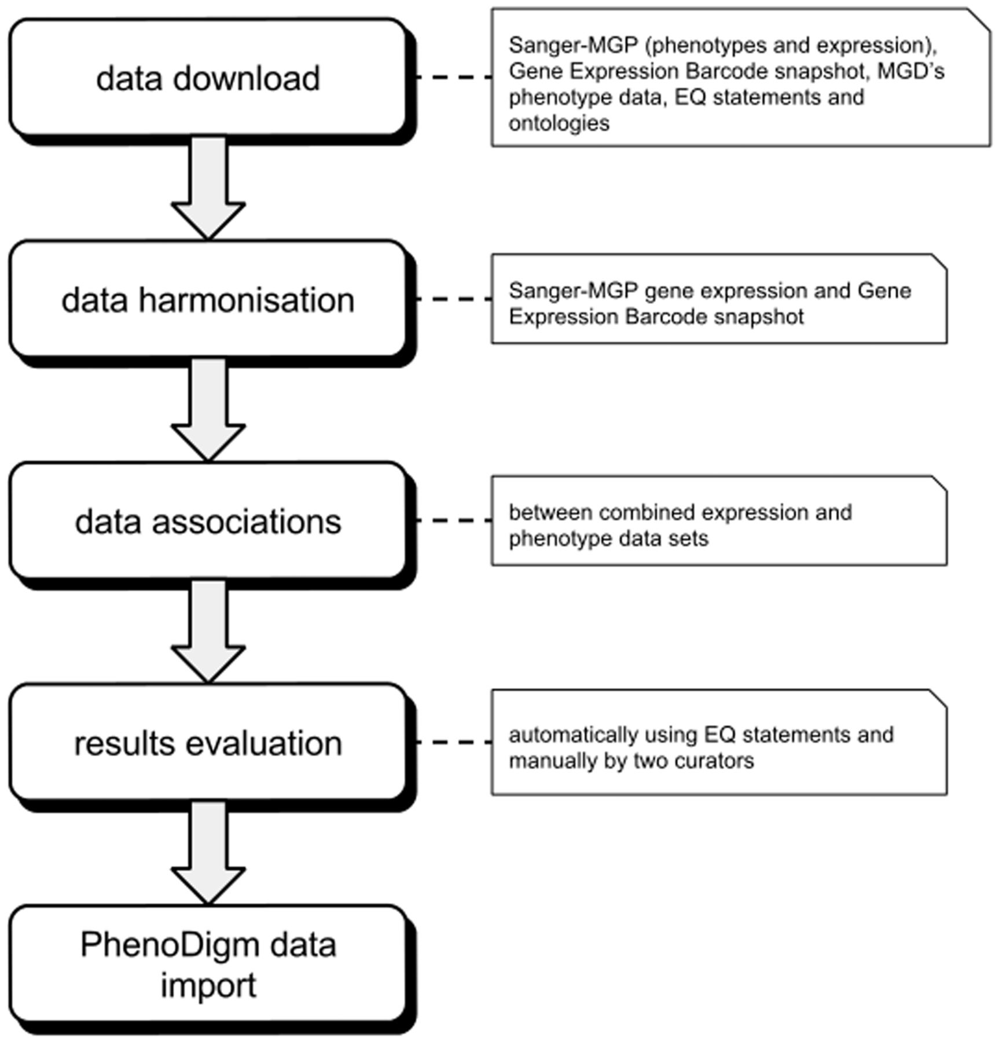
Figure 1. Illustration of the overall work flow of the study. After downloading and formatting all required data, the ...
Notes:
Figure 1. Illustration of the overall work flow of the study. After downloading and formatting all required data, the expression profiles are merged into one data set. The merged data set is then used to calculate the associations between tissues and phenotypes that are then evaluated. After evaluation, the significant associations are loaded into and provided via the PhenoDigm web interface.
Unless provided in the caption above, the following copyright applies to the content of this slide: © The Author(s) 2014. Published by Oxford University Press.This is an Open Access article distributed under the terms of the Creative Commons Attribution License (http://creativecommons.org/licenses/by/3.0/), which permits unrestricted reuse, distribution, and reproduction in any medium, provided the original work is properly cited.

Slide 2
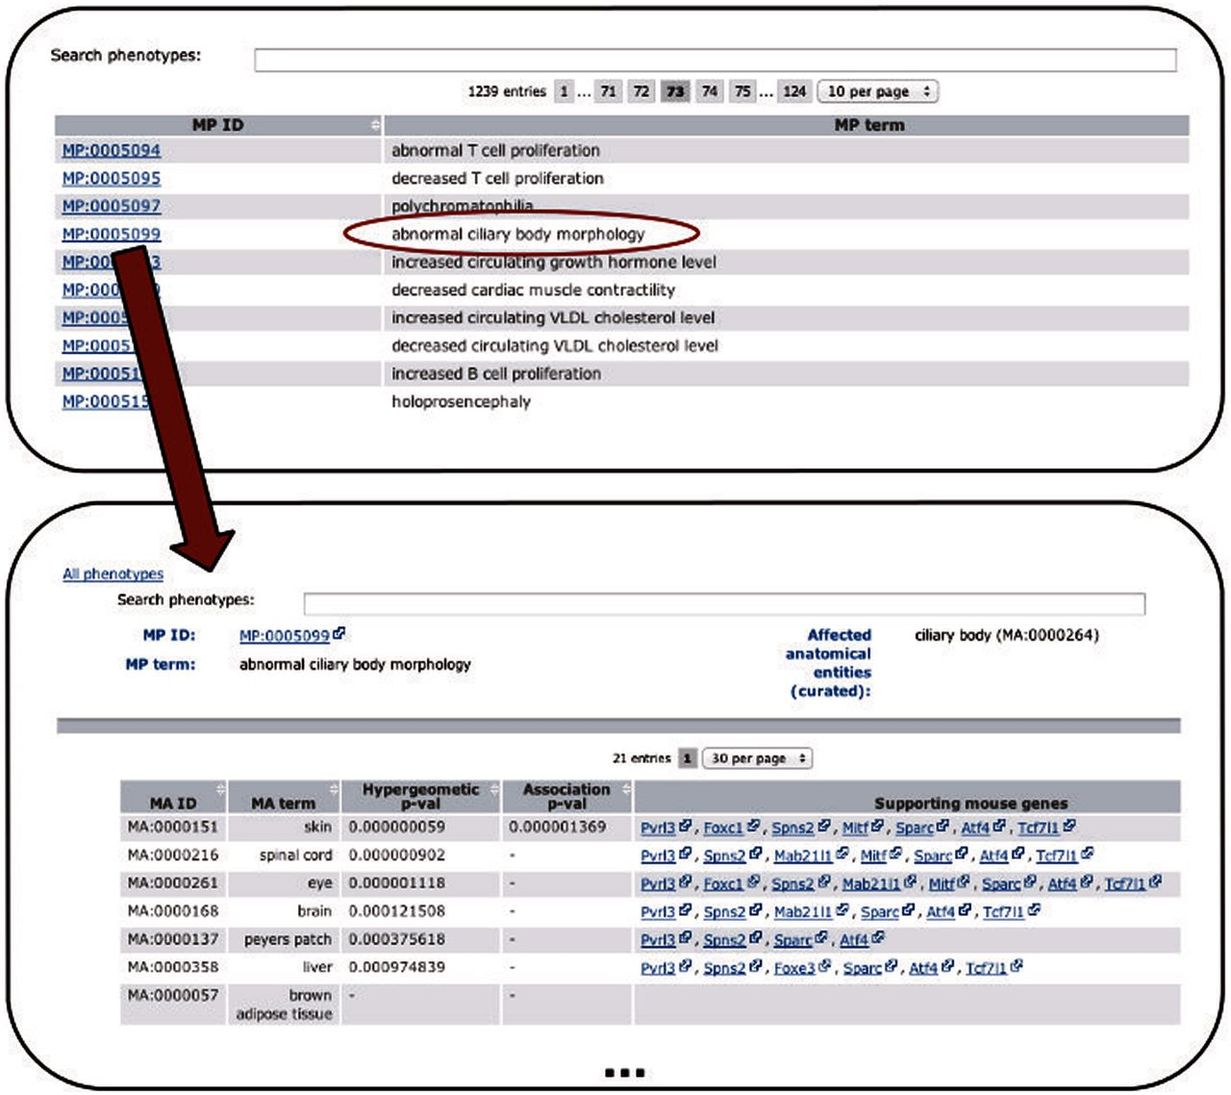
Figure 2. Depicts the extension of the PhenoDigm web interface and how the data can be browsed using the newly added ...
Notes:
Figure 2. Depicts the extension of the PhenoDigm web interface and how the data can be browsed using the newly added pages. From a list of phenotypes, those of interest can be selected, leading to a page that shows P -values for each of the investigated tissues. Hyphens in one of the P -value fields indicate that with the data set no significant association between the phenotype and the tissue could be identified. For significant associations, genes supporting the association between tissue and phenotype are provided.
Unless provided in the caption above, the following copyright applies to the content of this slide: © The Author(s) 2014. Published by Oxford University Press.This is an Open Access article distributed under the terms of the Creative Commons Attribution License (http://creativecommons.org/licenses/by/3.0/), which permits unrestricted reuse, distribution, and reproduction in any medium, provided the original work is properly cited.

