Slide 1
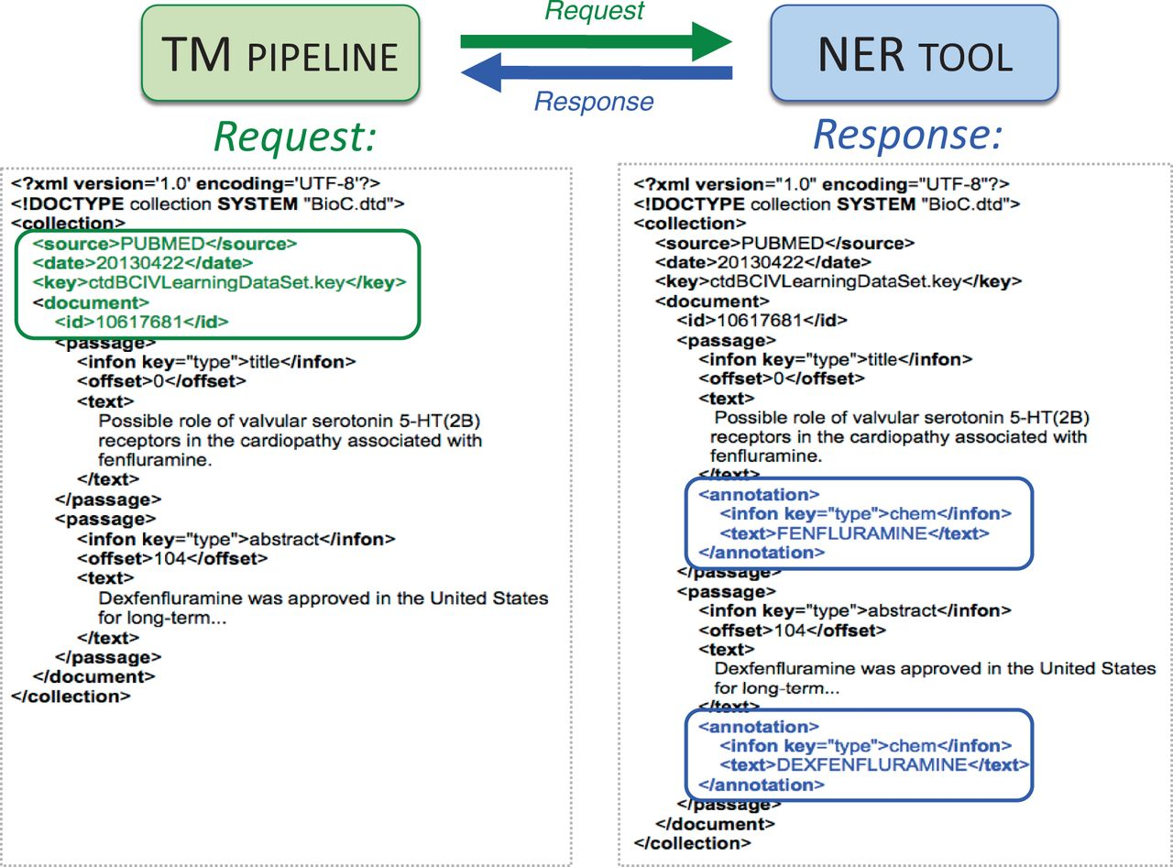
Figure 2. BioC-based high-level inter-process communications. A sample request in BioC format is sent by Web service ...
Notes:
Figure 2. BioC-based high-level inter-process communications. A sample request in BioC format is sent by Web service from the text-mining (TM) pipeline to the NER tool (green arrow). The PubMed ID, title, abstract and designated key file describing the semantics of the data are included within the XML request (left, green box). A chemical-specific response is returned from the NER tool to the TM pipeline (blue arrow). The NER Web service reads the BioC XML and attempts to identify chemicals in the title and abstract. Here, two chemical entities (fenfluramine and dexfenfluramine) are identified as BioC annotation objects for the NER chemical category in the response (right, blue boxes).
Unless provided in the caption above, the following copyright applies to the content of this slide: © The Author(s) 2014. Published by Oxford University Press.This is an Open Access article distributed under the terms of the Creative Commons Attribution License (http://creativecommons.org/licenses/by/3.0/), which permits unrestricted reuse, distribution, and reproduction in any medium, provided the original work is properly cited.

