Slide 1
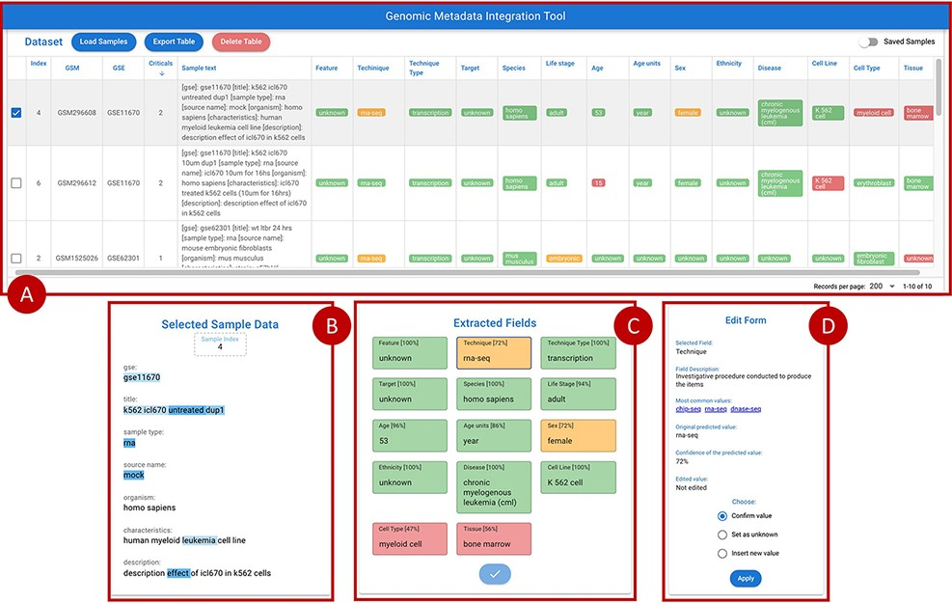
Figure 7. Overview of the GeMI interface, divided in four panels. Panel A represents loaded samples with original and ...
Notes:
Figure 7. Overview of the GeMI interface, divided in four panels. Panel A represents loaded samples with original and predicted information. Panel B provides the gradient-based saliency map related to the sample selected in the table above. Panel C shows the predicted values for the selected sample, also reporting the for accuracy of the prediction. Panel D allows users to actively modify the prediction of the model and save the suggestions.
Unless provided in the caption above, the following copyright applies to the content of this slide: © The Author(s) 2022. Published by Oxford University Press.This is an Open Access article distributed under the terms of the Creative Commons Attribution License (https://creativecommons.org/licenses/by/4.0/), which permits unrestricted reuse, distribution, and reproduction in any medium, provided the original work is properly cited.

