Slide 1
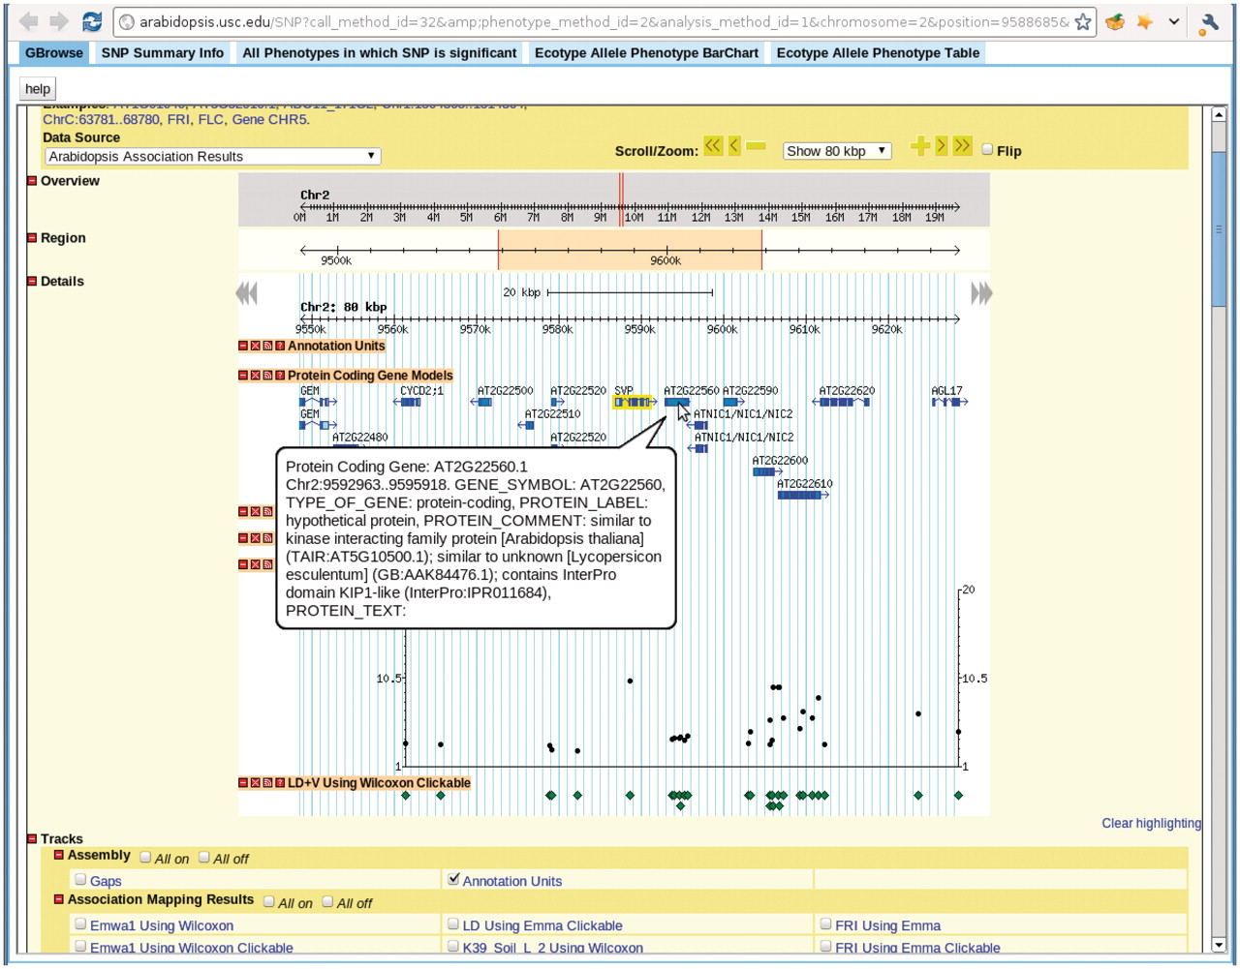
Figure 11. View for the SNP selected in Figure 7. There are five tabs in the view. First tab, GBrowse, is a close-up of ...
Notes:
Figure 11. View for the SNP selected in Figure 7. There are five tabs in the view. First tab, GBrowse, is a close-up of the association around the SNP. The ‘SNP Summary Info’ tab lists the position, P-value, annotation of the SNP. The ‘All Phenotypes in which SNP is significant’ tab lists other phenotypes in which this SNP is among the top 1000 associations. The ‘Ecotype Allele Phenotype BarChart’ is described in Figure 9. The ‘Ecotype Allele Phenotype Table’ is a table listing which accession carries which allele and the corresponding phenotype. This example is from http://arabidopsis.gmi.oeaw.ac.at:5000/SNP/?call_method_id=32&amp;phenotype_method_id=2&analysis_method_id=1&chromosome=2&position=9588685&score=10.1255444864.
Unless provided in the caption above, the following copyright applies to the content of this slide: © The Author(s) 2011. Published by Oxford University Press.This is Open Access article distributed under the terms of the Creative Commons Attribution Non-Commercial License (http://creativecommons.org/licenses/by-nc/2.5), which permits unrestricted non-commercial use, distribution, and reproduction in any medium, provided the original work is properly cited.

