Slide 1
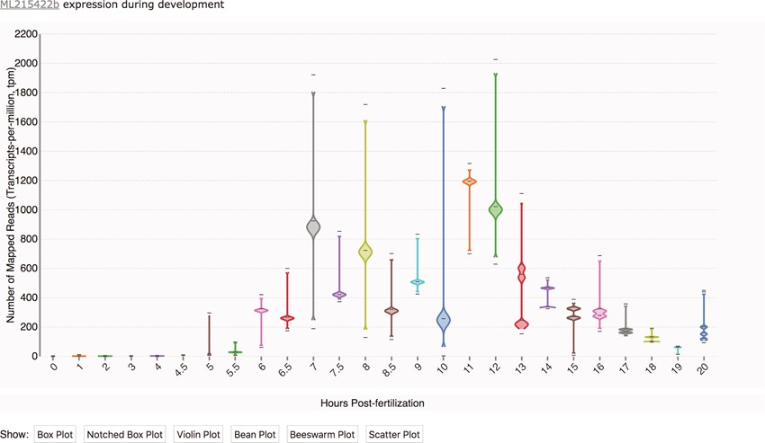
Figure 1 Transcriptomic data displayed as a time-course distribution plot for gene ML215422b. Time-course distribution ...
Notes:
Figure 1 Transcriptomic data displayed as a time-course distribution plot for gene ML215422b. Time-course distribution plots can be accessed through the ‘Temporal Developmental Expression Profile’ link on the MGP Portal home page. The expression profiles can be rendered in a variety of formats by clicking on the buttons immediately below the plot. Here, the profile is visualized as a bean plot.
Unless provided in the caption above, the following copyright applies to the content of this slide: Published by Oxford University Press 2020.This work is written by US Government employees and is in the public domain in the US.

Slide 2
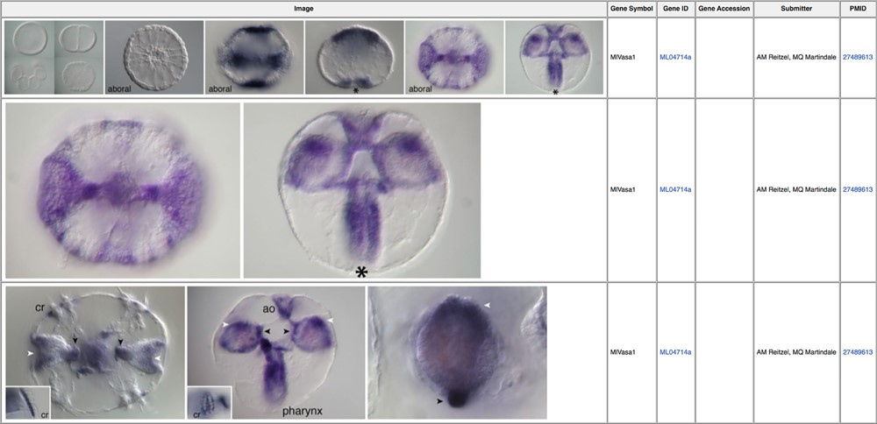
Figure 2 In situ images illustrating expression patterns for the germ cell marker vasa (MGP gene identifier ML04714a) ...
Notes:
Figure 2 In situ images illustrating expression patterns for the germ cell marker vasa (MGP gene identifier ML04714a) during early Mnemiopsis development (39). Linked PubMed identifiers in the right-most column bring the user to the PubMed manuscript entry in which these results were originally reported.
Unless provided in the caption above, the following copyright applies to the content of this slide: Published by Oxford University Press 2020.This work is written by US Government employees and is in the public domain in the US.

Slide 3
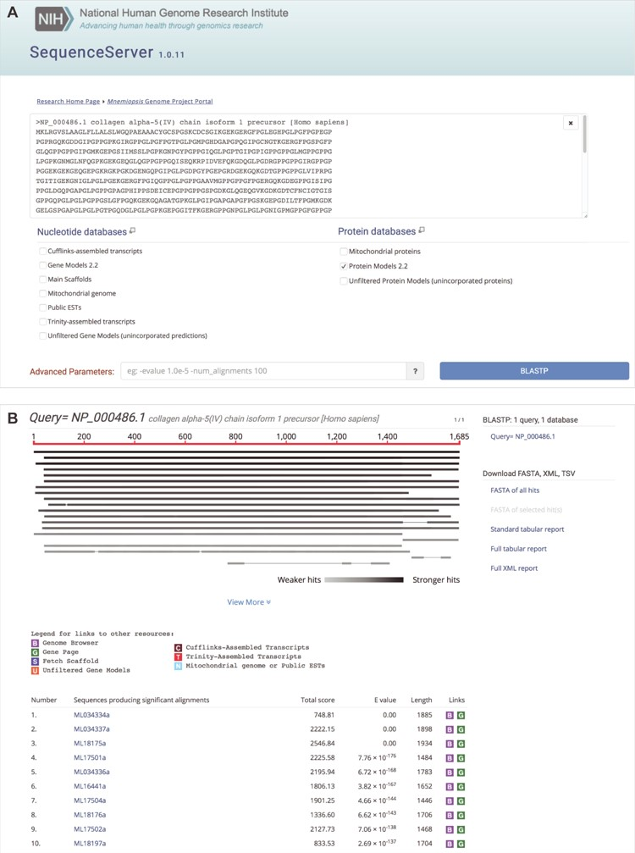
Figure 3 Mnemiopsis BLAST input options with sample output. (A) A user can paste one or more query sequences or drag a ...
Notes:
Figure 3 Mnemiopsis BLAST input options with sample output. (A) A user can paste one or more query sequences or drag a file containing query sequence(s) in FASTA format into the query search box. SequenceServer will automatically detect the sequence type (e.g. protein) and limit menu selections accordingly. Available nucleotide sequence databases include the Mnemiopsis genomic scaffolds (Main scaffolds), consensus gene prediction models (Gene Models 2.2), and Unfiltered Gene Models (unincorporated predictions), all publicly available Mnemiopsis ESTs and mRNAs from GenBank (Public ESTs), the Mnemiopsis mitochondrial genome, Cufflinks-assembled RNA-seq transcripts and Trinity-assembled RNA-seq transcripts. Available protein sequence databases include the translated proteins derived from the Mnemiopsis consensus gene prediction models (Protein Models 2.2), the unincorporated Mnemiopsis proteins derived from unincorporated gene prediction models (Unfiltered Protein Models) and the computationally derived Mnemiopsis mitochondrial proteins. SequenceServer will select the appropriate BLAST program (e.g. BLASTP) based on the input query and selected target database sequence types. Advanced BLAST parameters can be entered into the box at the bottom of the page in standard BLAST command line format. Clicking the ‘BLASTP’ button launches the BLAST search. (B) BLASTP results showing sequence alignments and scores, beginning with a graphical overview of each high-scoring segment pair (HSP). The identity of each HSP in this graphical overview can be seen by moving the mouse over each line in the display. A table containing summary results for each HSP can be found in the table below. Each of the ML sequences identified during this BLASTP search is hyperlinked, and clicking on those links takes the user directly to the pairwise alignment. The BLAST output results also feature customized color-coded boxes that link directly to relevant internal annotation resources, including the Mnemiopsis Genome Browser [B], the wiki-based Mnemiopsis Gene Pages [G], the Scaffold Fetch Tool [S], Unfiltered Gene Models [U], Cufflinks-assembled transcripts [C], Trinity-assembled transcripts [T] and Mitochondrial genome or Public ESTs [N].
Unless provided in the caption above, the following copyright applies to the content of this slide: Published by Oxford University Press 2020.This work is written by US Government employees and is in the public domain in the US.

Slide 4
Figure 4 An exploration of cell-type specificity for ML17501a using the Mnemiopsis ‘Single-Cell Expression’ tool ...
Notes:
Figure 4 An exploration of cell-type specificity for ML17501a using the Mnemiopsis ‘Single-Cell Expression’ tool identifies a single-cell cluster in cell type ‘Tentacle (potential venom)’ containing three of the four collagen IV genes (ML17501a, ML17502a and ML17504a). Clicking on a gene identifier link in the matrix takes the user directly to that gene entry in the Mnemiopsis Gene Wiki. Here, the original gene queried (ML17501a) is shown in bold italic type. Users can also view and download FASTA-formatted DNA (blue) and protein (green) sequences for all genes in a cluster by clicking on the desired sequence icon in the View Sequences column.
Unless provided in the caption above, the following copyright applies to the content of this slide: Published by Oxford University Press 2020.This work is written by US Government employees and is in the public domain in the US.

Slide 5
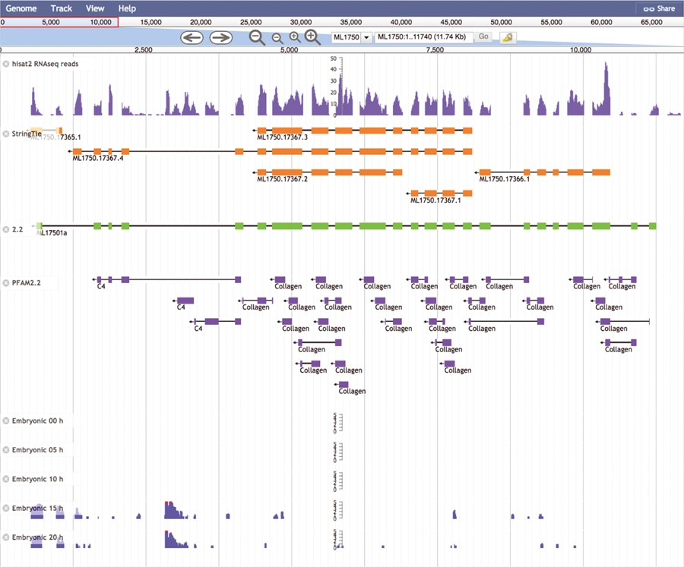
Figure 5 The Mnemiopsis Genome Browser displaying genomic scaffold ML1750. Zooming in on ML17501a and displaying the ...
Notes:
Figure 5 The Mnemiopsis Genome Browser displaying genomic scaffold ML1750. Zooming in on ML17501a and displaying the RNA-seq data from the Embryonic Developmental Time series track at 5-h increments (0, 5, 10, 15 and 20) indicates heightened expression at Hours 15 and 20 relative to earlier developmental time points. Note that the expression scales centered on the embryonic time series tracks are logarithmic. Expression values greater than 100 are truncated and colored red while all other expression values remain blue. The first two tracks above represent RNA-seq data (SRR1971491) derived from Mnemiopsis embryos that were aligned using HISAT2 and assembled into transcripts using StringTie. Also represented is the PFAM2.2 track displaying many collagen protein domains scattered across the entire length of the ML17501a gene.
Unless provided in the caption above, the following copyright applies to the content of this slide: Published by Oxford University Press 2020.This work is written by US Government employees and is in the public domain in the US.

Slide 6
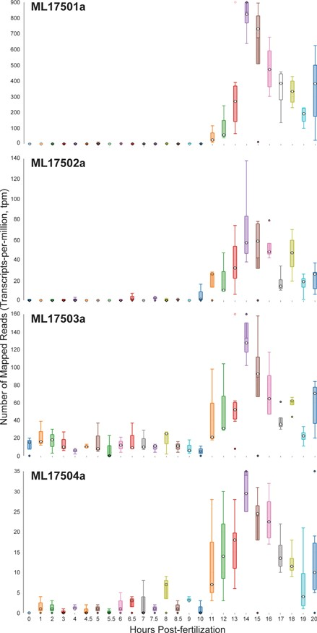
Figure 6 Time-course distribution plots for each of the four Mnemiopsis Group 1 collagen IV genes (ML17501a, ML17502a, ...
Notes:
Figure 6 Time-course distribution plots for each of the four Mnemiopsis Group 1 collagen IV genes (ML17501a, ML17502a, ML17503a and ML17504a) generated by searching the gene identifiers on the ‘Temporal Developmental Expression Profiles’ page. Each profile image depicts the gene expression during embryonic development for a single Mnemiopsis gene plotting the number of mapped reads (transcripts-per-million, tpm) from 0 to 20 hpf. Temporal developmental profiles show expression at specific and consistent times across the collagen IV gene cluster with a single-mode curve starting at Hour 11, peaking at Hour 14, and steadily decreasing down through Hour 20. This expression pattern is consistent with the embryonic developmental stage for tentacle growth in Mnemiopsis leidyi.
Unless provided in the caption above, the following copyright applies to the content of this slide: Published by Oxford University Press 2020.This work is written by US Government employees and is in the public domain in the US.

