Slide 1
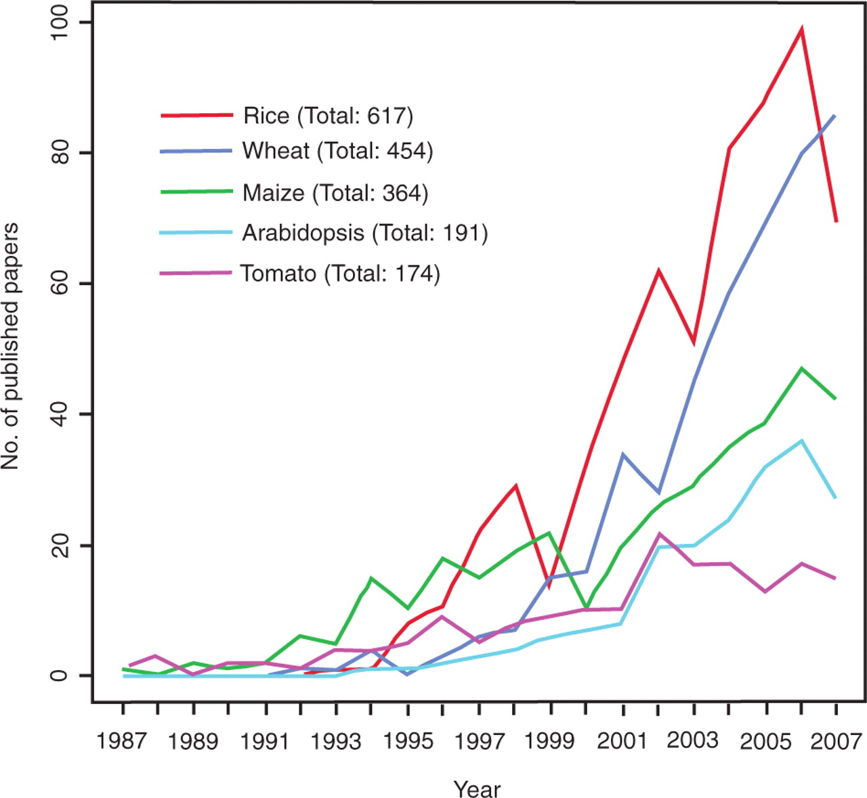
Figure 1. Number of published QTL papers for rice, wheat, maize, Arabidopsis and tomato between 1987 and 2007. Graph ...
Notes:
Figure 1. Number of published QTL papers for rice, wheat, maize, Arabidopsis and tomato between 1987 and 2007. Graph showing the steady increase in publications reporting QTLs in five major plant species between 1987 and 2007 based on nonredundant data from four publicly available literature databases, PubMed, Agricola, CAB Abstracts and BIOSIS Previews.
Unless provided in the caption above, the following copyright applies to the content of this slide: © 2009 The Author(s).This is Open Access article distributed under the terms of the Creative Commons Attribution Non-Commercial License (http://creativecommons.org/licenses/by-nc/2.0/uk/) which permits unrestricted non-commercial use, distribution, and reproduction in any medium, provided the original work is properly cited.

Slide 2
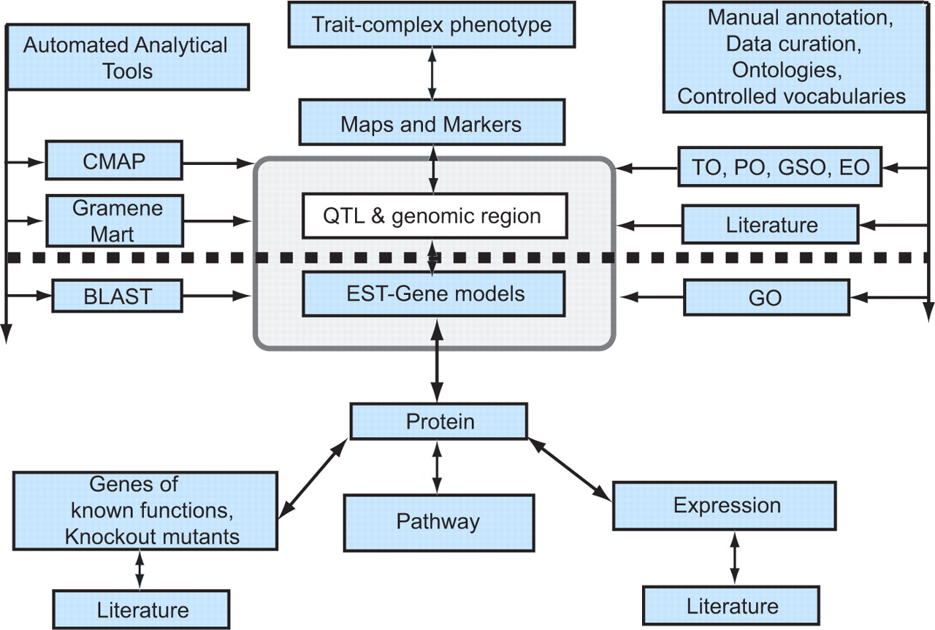
Figure 2. Generalized model for candidate gene discovery. The diagram shows a simplified view of the information ...
Notes:
Figure 2. Generalized model for candidate gene discovery. The diagram shows a simplified view of the information modules in the Gramene database. The figure has been designed to show the path of forward genetic dissection of complex traits above the dotted line and reverse genetic investigation below the heavy dotted line. In reality, as indicated by the arrows, the database can be accessed from any point of entry and users can navigate to the required information. Gramene provides automated analytical tools shown to the left of the pale grey box, and manual curation using ontologies and controlled vocabularies shown to the right of the dotted box, to enhance the data mining potential of the database. The association between the QTL and EST modules contained within the pale grey box highlights the fact that a user can systematically zero in on information about the relationship between a complex phenotype and a candidate gene/s of interest. As depicted here, a trait or complex phenotype is associated through maps and markers to a genomic region identified as a QTL and to ESTs and gene models previously annotated to the genome region; the QTL database thus performs the crucial function of connecting molecular or genotypic information with complex phenotypes, and more generally connecting the field of molecular biology with that of quantitative genetics and plant breeding.
Unless provided in the caption above, the following copyright applies to the content of this slide: © 2009 The Author(s).This is Open Access article distributed under the terms of the Creative Commons Attribution Non-Commercial License (http://creativecommons.org/licenses/by-nc/2.0/uk/) which permits unrestricted non-commercial use, distribution, and reproduction in any medium, provided the original work is properly cited.

Slide 3
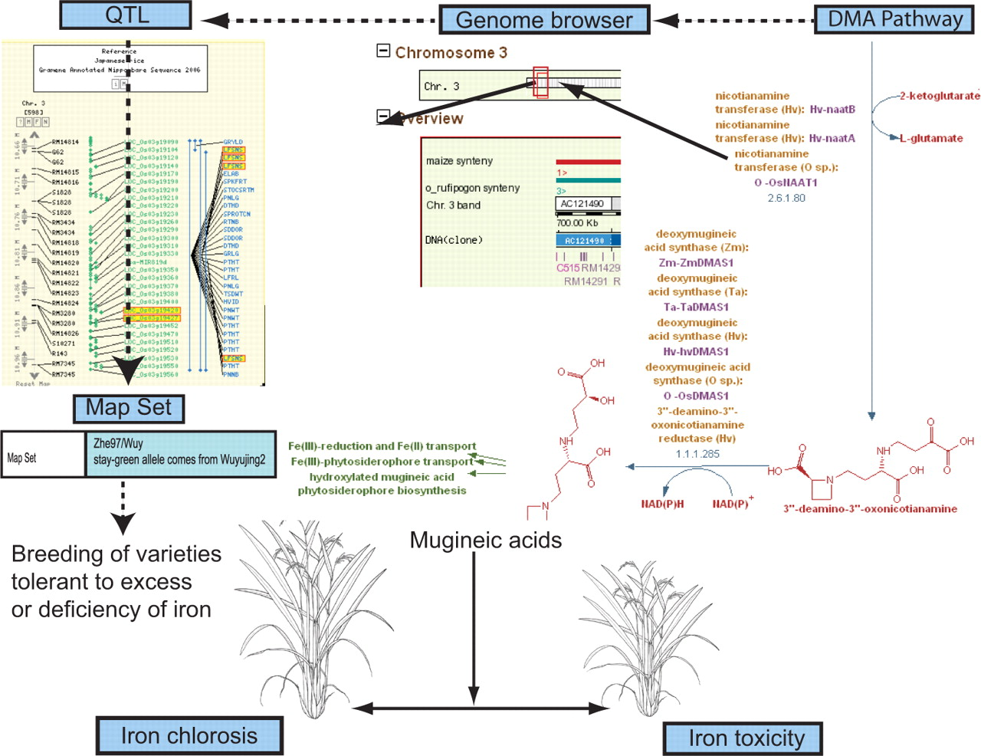
Figure 3. Iron-uptake pathway in rice: cloned gene to complex traits, via pathway, genes and QTLs. Leaf senescence QTLs ...
Notes:
Figure 3. Iron-uptake pathway in rice: cloned gene to complex traits, via pathway, genes and QTLs. Leaf senescence QTLs aligned to CMap view of rice chromosome 3 shown in the top left corner; Genome Browser view of QTL region of rice chromosome 3 with associated gene models shown in the center; DMA metabolic pathway shown in the top right; rice plants expressing iron chlorosis tolerant phenotype and iron toxicity phenotype shown at the bottom. The Mugenic acids (MAs) or phytosiderophores are end products of the DMA metabolic pathway. Biosynthesis of MAs is closely linked to iron deficiency and is highly regulated to avoid toxicity owing to excess iron uptake. The figure represents parts of the curated DMA pathway; the genomic positions of the cloned genes from this pathway are used to trace suitable QTL candidates in that region. The populations from which these QTLs were analyzed can then be used in breeding programs aimed at developing rice varieties that are tolerant to soil environments characterized by deficiencies or excesses of iron.
Unless provided in the caption above, the following copyright applies to the content of this slide: © 2009 The Author(s).This is Open Access article distributed under the terms of the Creative Commons Attribution Non-Commercial License (http://creativecommons.org/licenses/by-nc/2.0/uk/) which permits unrestricted non-commercial use, distribution, and reproduction in any medium, provided the original work is properly cited.

