Slide 1
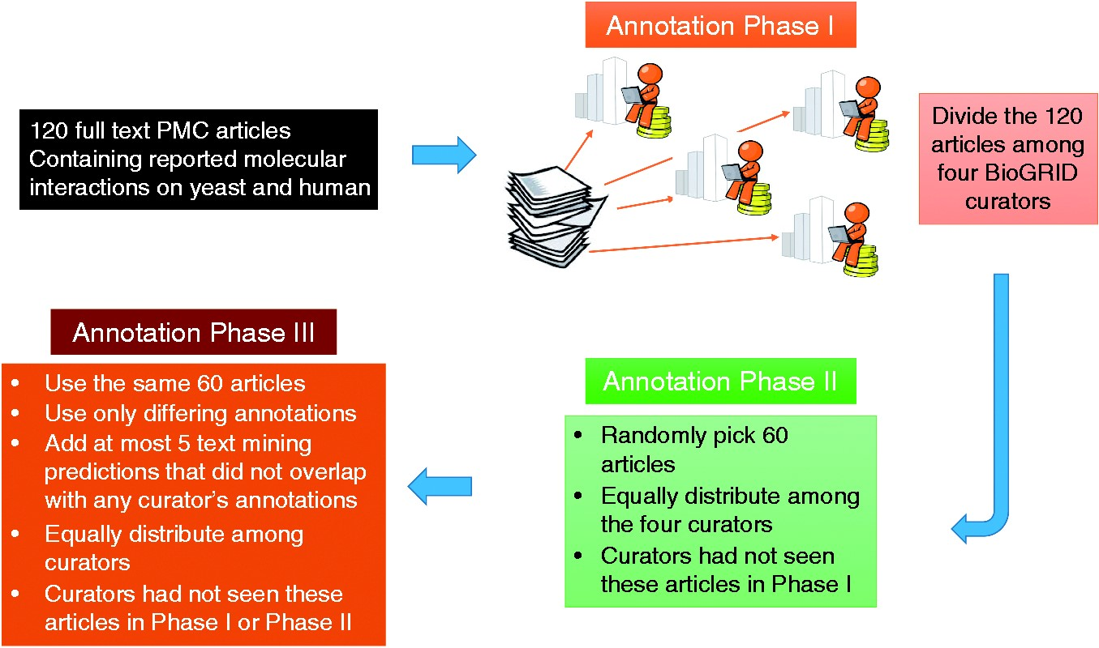
Figure 3. Annotation process for the BioC-BioGRID corpus. Phase I and II equally distributed the articles selected for ...
Notes:
Figure 3. Annotation process for the BioC-BioGRID corpus. Phase I and II equally distributed the articles selected for curation among four curators so that curators had not seen the same article before. Articles contained no annotations, and curators were asked to curate them and mark the useful interactions information using the annotation interface. During Phase III, articles were equally distributed and curators were assigned articles not seen previously. Phase III articles contained pre-highlighted passages: text-mining predictions and passages annotated by only one of the Phases I or II annotators. This annotation phase asked the curators to review the annotations and remove the ones that were not useful for curation.
Unless provided in the caption above, the following copyright applies to the content of this slide: Published by Oxford University Press 2017. This work is written by US Government employees and is in the public domain in the US.

