Slide 1
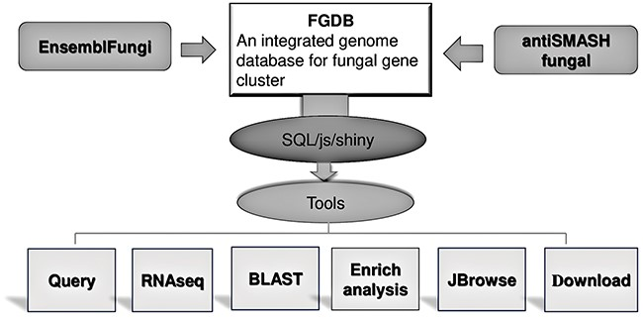
Figure 1. FGCD database structure and function It includes the composition of the database as well as the data sources ...
Notes:
Figure 1. FGCD database structure and function It includes the composition of the database as well as the data sources and functions provided.
Unless provided in the caption above, the following copyright applies to the content of this slide: © The Author(s) 2024. Published by Oxford University Press.This is an Open Access article distributed under the terms of the Creative Commons Attribution License (https://creativecommons.org/licenses/by/4.0/), which permits unrestricted reuse, distribution, and reproduction in any medium, provided the original work is properly cited.

Slide 2
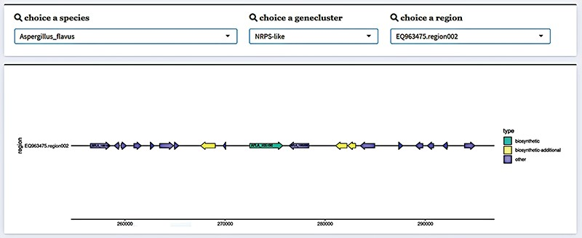
Figure 2. Gene cluster structure information display in FGCD. The selected data can be visually displayed by filtering ...
Notes:
Figure 2. Gene cluster structure information display in FGCD. The selected data can be visually displayed by filtering through the selection box above.
Unless provided in the caption above, the following copyright applies to the content of this slide: © The Author(s) 2024. Published by Oxford University Press.This is an Open Access article distributed under the terms of the Creative Commons Attribution License (https://creativecommons.org/licenses/by/4.0/), which permits unrestricted reuse, distribution, and reproduction in any medium, provided the original work is properly cited.

Slide 3
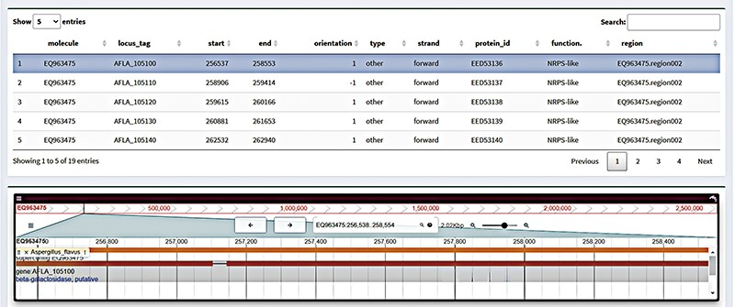
Figure 3. Gene browser interface in FGCD. Click on the table above to display the selected gene in the genome browser.
Notes:
Figure 3. Gene browser interface in FGCD. Click on the table above to display the selected gene in the genome browser.
Unless provided in the caption above, the following copyright applies to the content of this slide: © The Author(s) 2024. Published by Oxford University Press.This is an Open Access article distributed under the terms of the Creative Commons Attribution License (https://creativecommons.org/licenses/by/4.0/), which permits unrestricted reuse, distribution, and reproduction in any medium, provided the original work is properly cited.

Slide 4
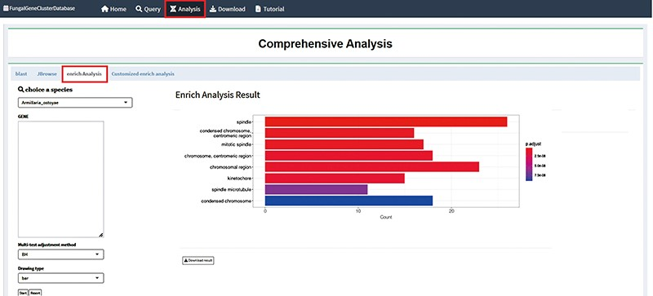
Figure 4. Enrichment analysis interface in FGCD. The obtained gene clusters were used as background information for ...
Notes:
Figure 4. Enrichment analysis interface in FGCD. The obtained gene clusters were used as background information for enrichment analysis.
Unless provided in the caption above, the following copyright applies to the content of this slide: © The Author(s) 2024. Published by Oxford University Press.This is an Open Access article distributed under the terms of the Creative Commons Attribution License (https://creativecommons.org/licenses/by/4.0/), which permits unrestricted reuse, distribution, and reproduction in any medium, provided the original work is properly cited.

Slide 5
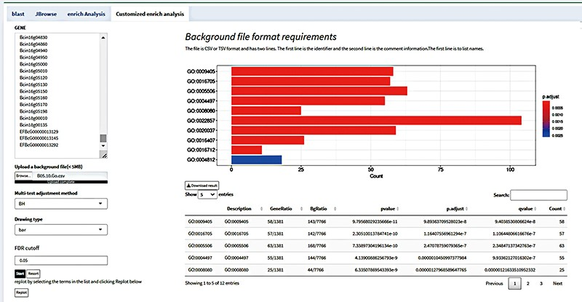
Figure 5. Customize enrichment analysis by uploading background files according to the format.
Notes:
Figure 5. Customize enrichment analysis by uploading background files according to the format.
Unless provided in the caption above, the following copyright applies to the content of this slide: © The Author(s) 2024. Published by Oxford University Press.This is an Open Access article distributed under the terms of the Creative Commons Attribution License (https://creativecommons.org/licenses/by/4.0/), which permits unrestricted reuse, distribution, and reproduction in any medium, provided the original work is properly cited.

