Slide 1
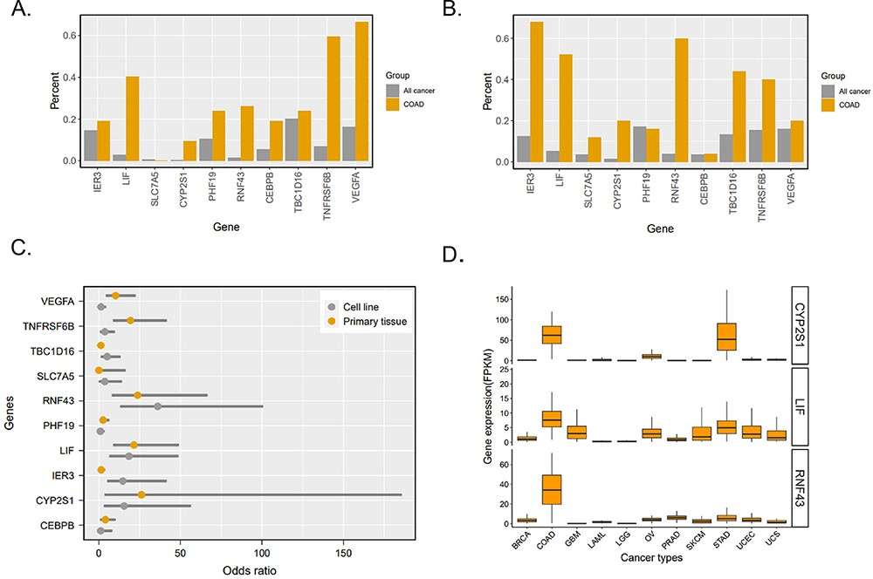
Figure 3. Analysis of 10 gene-related super-enhancers in colorectal cancer. (A) Percentage of 10 gene-related ...
Notes:
Figure 3. Analysis of 10 gene-related super-enhancers in colorectal cancer. (A) Percentage of 10 gene-related super-enhancers detected in primary tissue samples. ‘All cancer’ indicates cancer types excluding COAD. (B) Percentage of 10 gene-related super-enhancers detected in cell line samples. ‘All cancer’ indicates cancer types excluding COAD. (C) Ten genes’ odds ratio of super-enhancers detected in colorectal cancer to those detected in all other cancers. (D) Three genes’ expression (fragments per kilobase of exon per million mapped fragments, FPKM) in different cancer types according to TCGA RNA-Seq.
Unless provided in the caption above, the following copyright applies to the content of this slide: © The Author(s) 2023. Published by Oxford University Press.This is an Open Access article distributed under the terms of the Creative Commons Attribution License (https://creativecommons.org/licenses/by/4.0/), which permits unrestricted reuse, distribution, and reproduction in any medium, provided the original work is properly cited.

