Slide 1
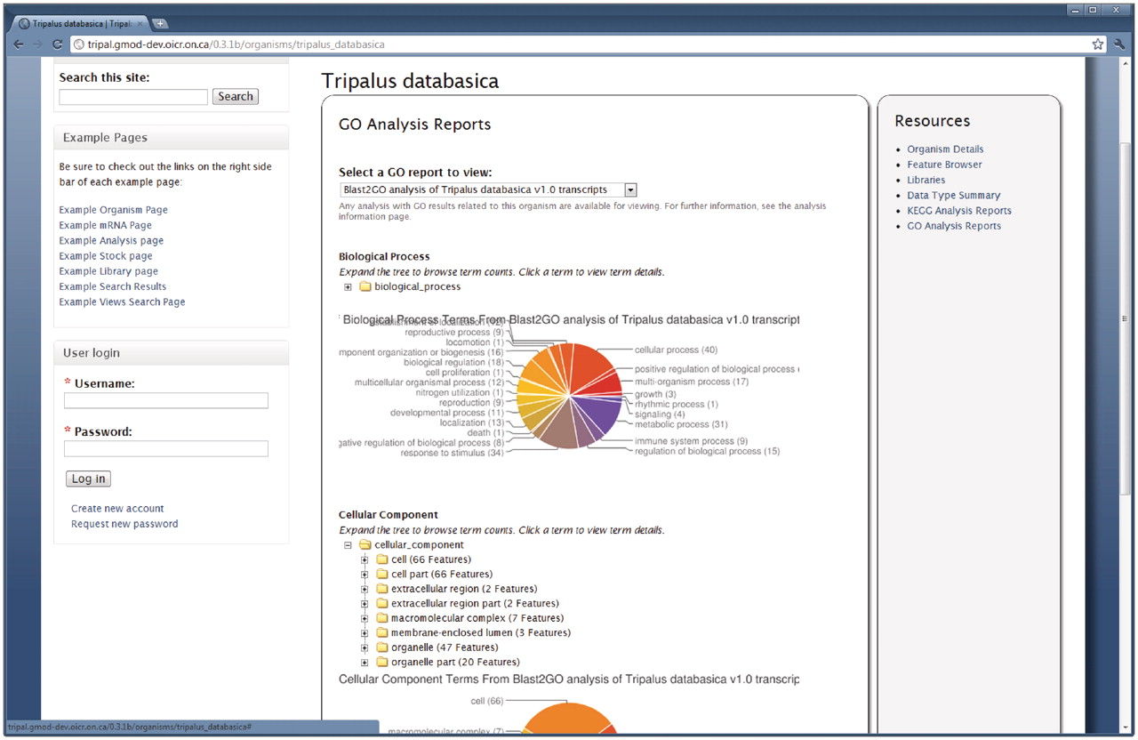
Figure 2. The GO summary on the Organism page. The Tripal Analysis GO module provides summarized reports of GO ...
Notes:
Figure 2. The GO summary on the Organism page. The Tripal Analysis GO module provides summarized reports of GO annotations for an organism. This report is available by clicking the ‘Go Analysis Reports’ link on the right sidebar of the Organism page. The report shown above is a summarized report from a Blast2GO analysis. The pie charts indicate the percentage of annotations for each of the highest level terms in each of the three branches of the GO. Additionally, expandable trees for each branch are available for browsing all of the assignments. Users can click a GO term in the tree for a description of the term and download a FASTA file of sequences annotated with a particular term.
Unless provided in the caption above, the following copyright applies to the content of this slide: © The Author(s) 2011. Published by Oxford University Press.This is an Open Access article distributed under the terms of the Creative Commons Attribution Non-Commercial License (http://creativecommons.org/licenses/by-nc/3.0), which permits unrestricted non-commercial use, distribution, and reproduction in any medium, provided the original work is properly cited.

