Slide 1
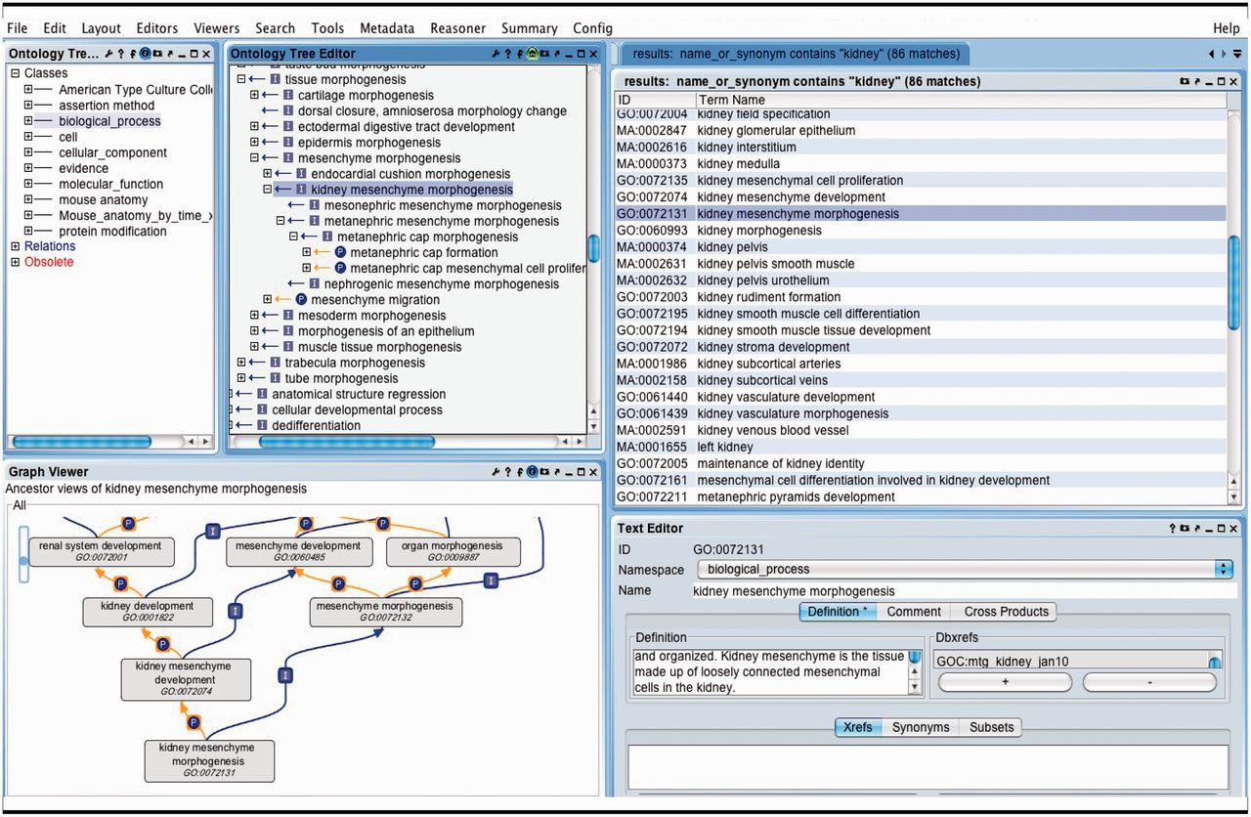
Figure 7. OBO-Edit ontology tool used to browse multiple OBO ontologies. The far left panel shows the vocabularies that ...
Notes:
Figure 7. OBO-Edit ontology tool used to browse multiple OBO ontologies. The far left panel shows the vocabularies that have been loaded for searching and viewing. The right panel displays the terms in all of the vocabularies that contain the word ‘kidney’. The GO term ‘kidney mesenchyme morphogenesis’ is selected and is visible as a tree view showing its children (middle panel), and as a graphical view showing its parents (lower left).
Unless provided in the caption above, the following copyright applies to the content of this slide: © The Author(s) 2012. Published by Oxford University Press.This is an Open Access article distributed under the terms of the Creative Commons Attribution License (http://creativecommons.org/licenses/by-nc/3.0/), which permits non-commercial reuse, distribution, and reproduction in any medium, provided the original work is properly cited. For commercial re-use, please contact journals.permissions@oup.com.

