Slide 1
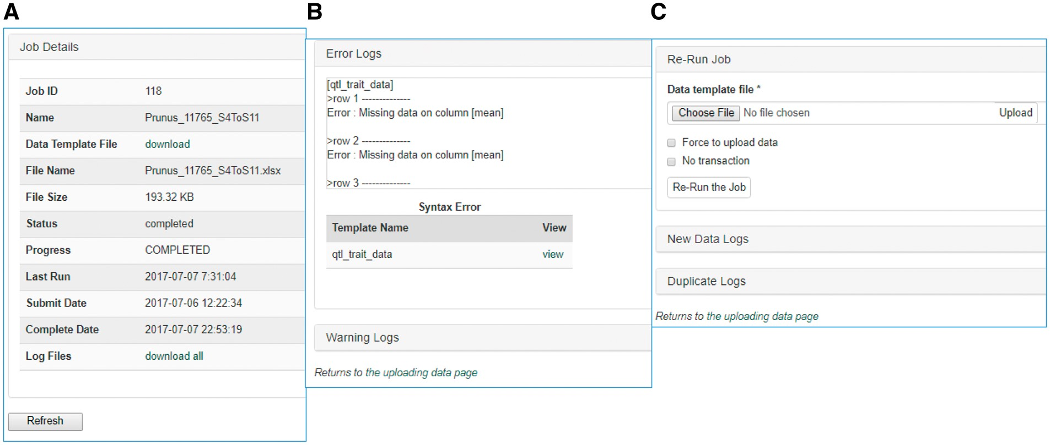
Figure 4. Sections of an uploading job detail page in MCL. (A) A table shows the details of the uploading job. (B) A ...
Notes:
Figure 4. Sections of an uploading job detail page in MCL. (A) A table shows the details of the uploading job. (B) A window that shows error logs. (C) A section where users can re-run the job after fixing any errors. New data logs show any new data that have been uploaded and the duplicate logs show any data in the template that already exist in the database.
Unless provided in the caption above, the following copyright applies to the content of this slide: © The Author(s) 2017. Published by Oxford University Press.This is an Open Access article distributed under the terms of the Creative Commons Attribution License (http://creativecommons.org/licenses/by/4.0/), which permits unrestricted reuse, distribution, and reproduction in any medium, provided the original work is properly cited.

