Slide 1
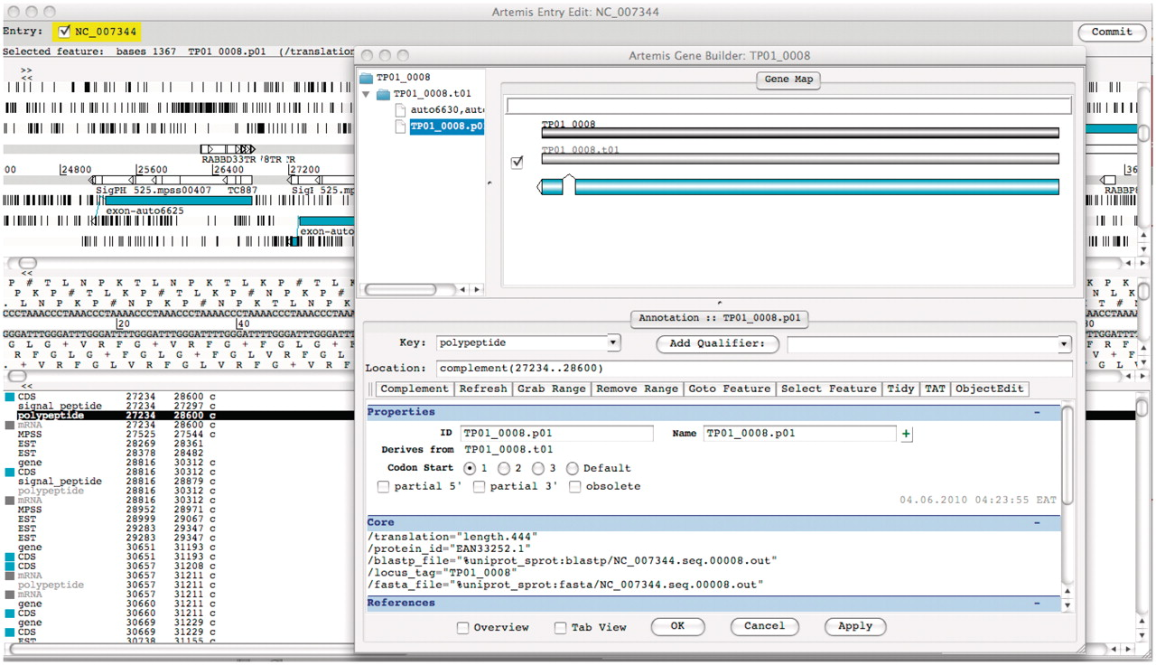
Figure 3. Screenshot of Artemis annotation tool allowing direct access to T. parva genome data in the TparvaDB database ...
Notes:
Figure 3. Screenshot of Artemis annotation tool allowing direct access to T. parva genome data in the TparvaDB database for online annotation. Background image depicts Artemis interface and foreground image depict Gene Builder view.
Unless provided in the caption above, the following copyright applies to the content of this slide: © The Author(s) 2011. Published by Oxford University Press.This is Open Access article distributed under the terms of the Creative Commons Attribution Non-Commercial License (http://creativecommons.org/licenses/by-nc/2.5), which permits unrestricted non-commercial use, distribution, and reproduction in any medium, provided the original work is properly cited.

