Slide 1
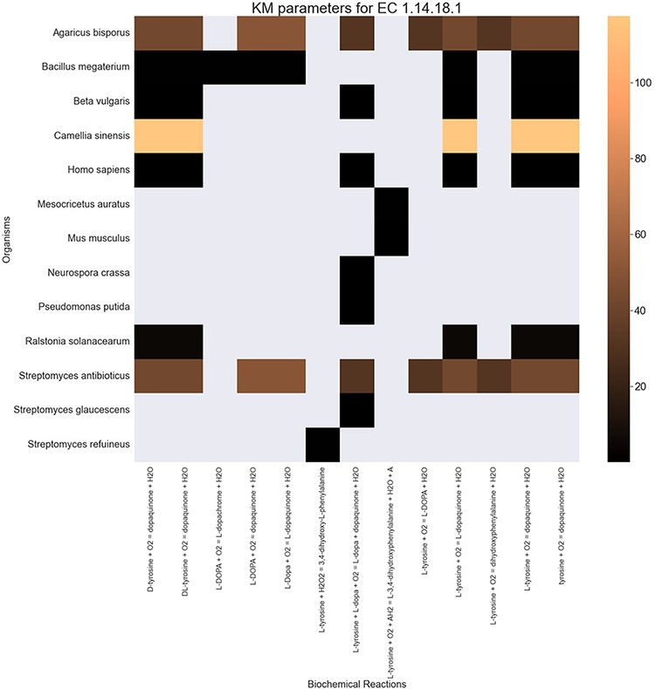
Figure 7. A heatmap of ${{\rm{K}}_{\rm{M}}}$ values for all the reactions catalysed by 1.14.18.1 (x-axis) seen in ...
Notes:
Figure 7. A heatmap of ${{\rm{K}}_{\rm{M}}}$ values for all the reactions catalysed by 1.14.18.1 (x-axis) seen in particular organisms (y-axis).
Unless provided in the caption above, the following copyright applies to the content of this slide: © The Author(s) 2022. Published by Oxford University Press.This is an Open Access article distributed under the terms of the Creative Commons Attribution-NonCommercial License (https://creativecommons.org/licenses/by-nc/4.0/), which permits non-commercial re-use, distribution, and reproduction in any medium, provided the original work is properly cited. For commercial re-use, please contact journals.permissions@oup.com

