Slide 1
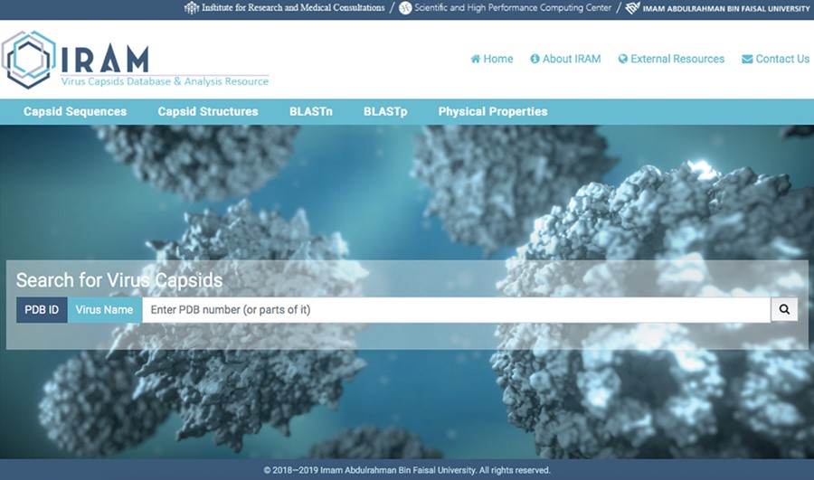
Figure 1 Snapshot of IRAM homepage.
Notes:
Figure 1 Snapshot of IRAM homepage.
Unless provided in the caption above, the following copyright applies to the content of this slide: © The Author(s) 2019. Published by Oxford University Press.This is an Open Access article distributed under the terms of the Creative Commons Attribution License (http://creativecommons.org/licenses/by/4.0/), which permits unrestricted reuse, distribution, and reproduction in any medium, provided the original work is properly cited.

Slide 2
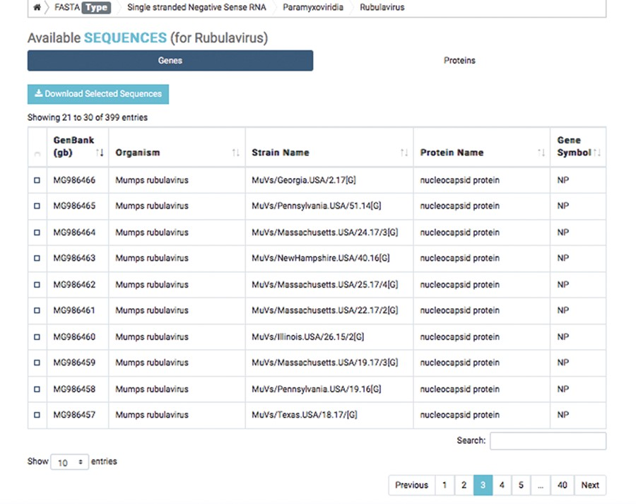
Figure 2 Detailed result of capsid nucleotide and amino acid sequences of a selected virus.
Notes:
Figure 2 Detailed result of capsid nucleotide and amino acid sequences of a selected virus.
Unless provided in the caption above, the following copyright applies to the content of this slide: © The Author(s) 2019. Published by Oxford University Press.This is an Open Access article distributed under the terms of the Creative Commons Attribution License (http://creativecommons.org/licenses/by/4.0/), which permits unrestricted reuse, distribution, and reproduction in any medium, provided the original work is properly cited.

Slide 3
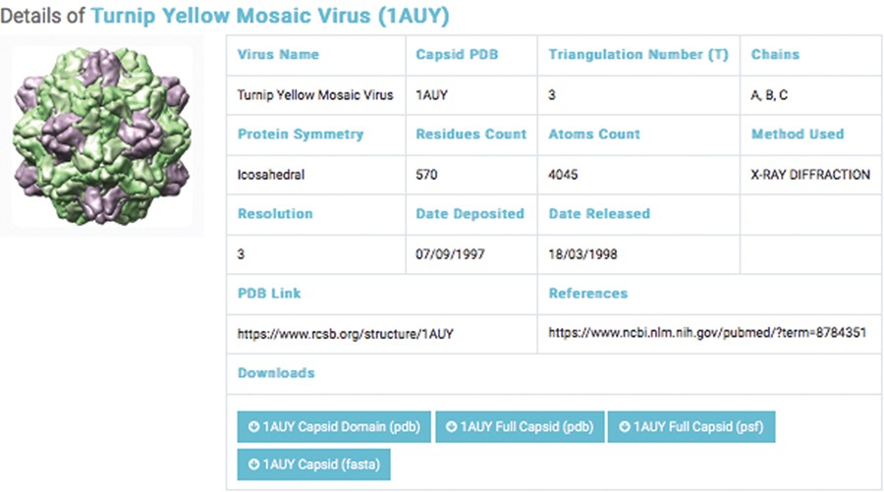
Figure 3 Details of a selected capsids structure. Capsid files: capsid domain PDB, full capsids PDB, full capsid PSF ...
Notes:
Figure 3 Details of a selected capsids structure. Capsid files: capsid domain PDB, full capsids PDB, full capsid PSF and capsid FASTA.
Unless provided in the caption above, the following copyright applies to the content of this slide: © The Author(s) 2019. Published by Oxford University Press.This is an Open Access article distributed under the terms of the Creative Commons Attribution License (http://creativecommons.org/licenses/by/4.0/), which permits unrestricted reuse, distribution, and reproduction in any medium, provided the original work is properly cited.

Slide 4
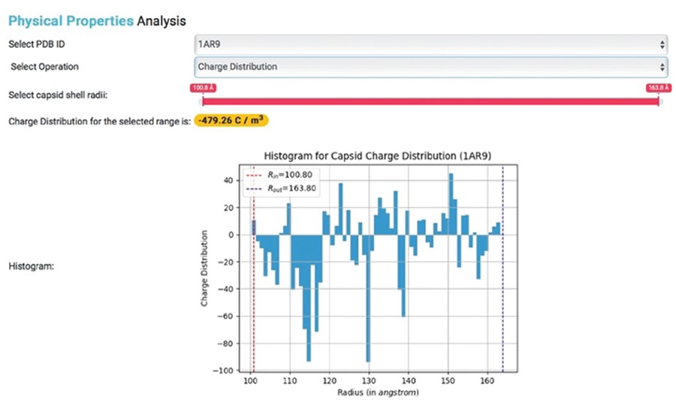
Figure 4 Physical properties analysis. Histogram showing the charge distribution of a selected capsid PDB ID, where ...
Notes:
Figure 4 Physical properties analysis. Histogram showing the charge distribution of a selected capsid PDB ID, where Rin represents inner capsid radii and Rout represents outer capsid radii.
Unless provided in the caption above, the following copyright applies to the content of this slide: © The Author(s) 2019. Published by Oxford University Press.This is an Open Access article distributed under the terms of the Creative Commons Attribution License (http://creativecommons.org/licenses/by/4.0/), which permits unrestricted reuse, distribution, and reproduction in any medium, provided the original work is properly cited.

