Slide 1
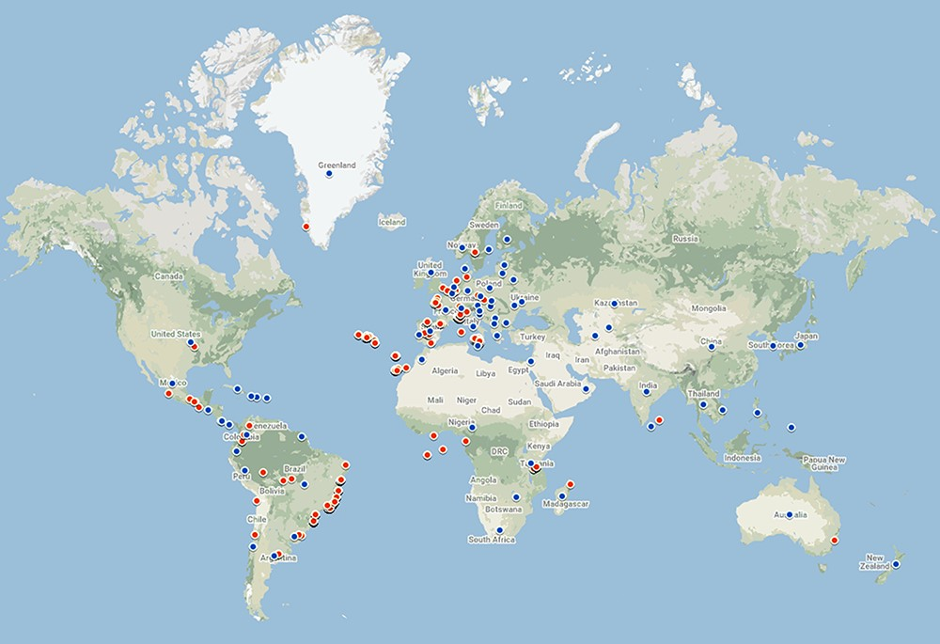
Figure 3. Geographic coverage of the data currently in the database. Red points represent geo-referenced records, while ...
Notes:
Figure 3. Geographic coverage of the data currently in the database. Red points represent geo-referenced records, while blue points are country centroids (for records that do not have an exact geographical reference). There are records from 70 countries and 479 locations. The map was created using Google Maps.
Unless provided in the caption above, the following copyright applies to the content of this slide: © The Author(s) 2021. Published by Oxford University Press.This is an Open Access article distributed under the terms of the Creative Commons Attribution License (https://creativecommons.org/licenses/by/4.0/), which permits unrestricted reuse, distribution, and reproduction in any medium, provided the original work is properly cited.

