Slide 1
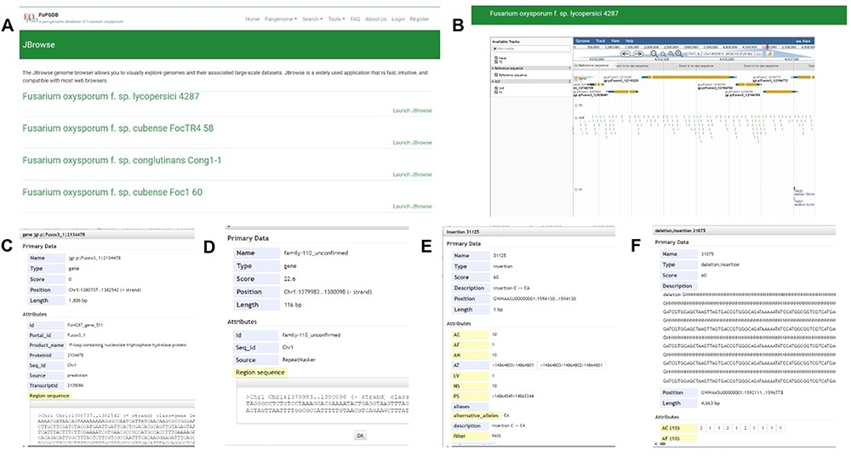
Figure 7. JBrowse section under the Tools module. (A) Page of genome browser index, (B) available tracks for different ...
Notes:
Figure 7. JBrowse section under the Tools module. (A) Page of genome browser index, (B) available tracks for different types of genomic features, (C) a window showing detailed information of the target gene model, (D) TE information, (E) SNPs and INDELs information for 35 Fusarium oxysporum accessions, (F) SVs’ information for 35 F. oxysporum accessions.
Unless provided in the caption above, the following copyright applies to the content of this slide: © The Author(s) 2024. Published by Oxford University Press.This is an Open Access article distributed under the terms of the Creative Commons Attribution License (https://creativecommons.org/licenses/by/4.0/), which permits unrestricted reuse, distribution, and reproduction in any medium, provided the original work is properly cited.

