Slide 1
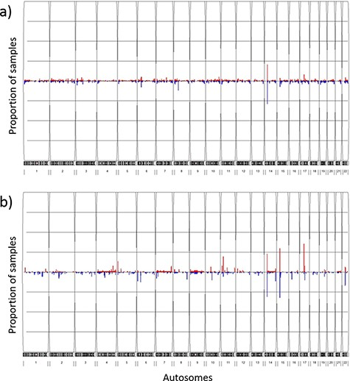
Figure 4. Frequency plots of CNVs in the TWCNV and HapMap datasets Red color represents duplication while blue color ...
Notes:
Figure 4. Frequency plots of CNVs in the TWCNV and HapMap datasets Red color represents duplication while blue color represents deletion. The x-axis contains the 22 autosomes, and the y-axis shows the proportion of samples showing CNVs in the two datasets. (a) Frequency plot of CNVs in 15 829 Taiwanese individuals. (b) Frequency plot of CNVs in 87 Asians in the HapMap dataset.
Unless provided in the caption above, the following copyright applies to the content of this slide: © The Author(s) 2021. Published by Oxford University Press.This is an Open Access article distributed under the terms of the Creative Commons Attribution License (http://creativecommons.org/licenses/by/4.0/), which permits unrestricted reuse, distribution, and reproduction in any medium, provided the original work is properly cited.

