Slide 1
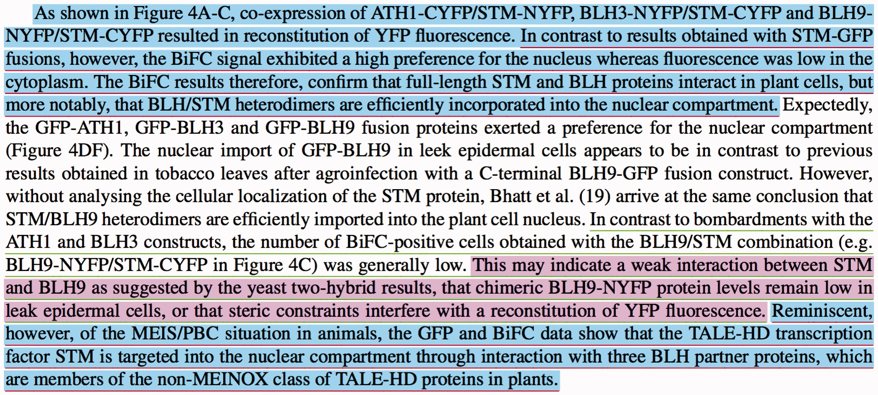
Figure 8. An example paragraph which shows our evaluation logic over three sample manual and system annotations. The ...
Notes:
Figure 8. An example paragraph which shows our evaluation logic over three sample manual and system annotations. The manually annotated passages are underlined with red and green for ‘bimolecular fluorescence complementation’ (MI:0809) and ‘two hybrid’ (MI:0018) experimental methods, respectively. The annotated passages by the system are colored with blue and purple for ‘bimolecular fluorescence complementation’ (MI:0809) and ‘two hybrid’ (MI:0018) experimental methods, respectively.
Unless provided in the caption above, the following copyright applies to the content of this slide: © The Author(s) 2017. Published by Oxford University Press.This is an Open Access article distributed under the terms of the Creative Commons Attribution License (http://creativecommons.org/licenses/by/4.0/), which permits unrestricted reuse, distribution, and reproduction in any medium, provided the original work is properly cited.

