Slide 1
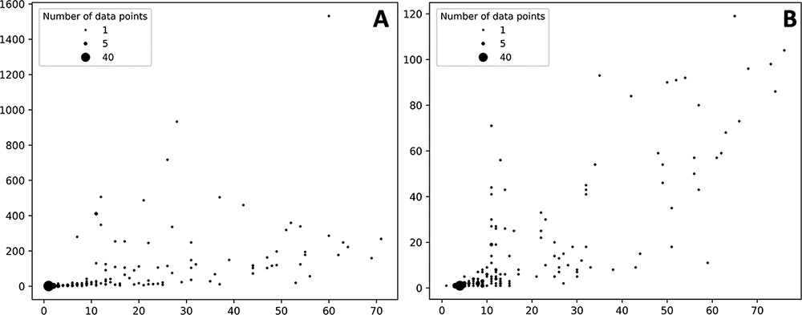
Figure 3. Bubble plots showing the number of drugs per protein (X axis) vs number of statistically significant ADR per ...
Notes:
Figure 3. Bubble plots showing the number of drugs per protein (X axis) vs number of statistically significant ADR per protein (Y axis). (A) Distribution of the self-reporting set; (B) distribution of the curate set. Refer to the ‘Material and methods’ section for the description of self-reporting and curated sets.
Unless provided in the caption above, the following copyright applies to the content of this slide: © The Author(s) 2021. Published by Oxford University Press.This is an Open Access article distributed under the terms of the Creative Commons Attribution License (https://creativecommons.org/licenses/by/4.0/), which permits unrestricted reuse, distribution, and reproduction in any medium, provided the original work is properly cited.

