Slide 1
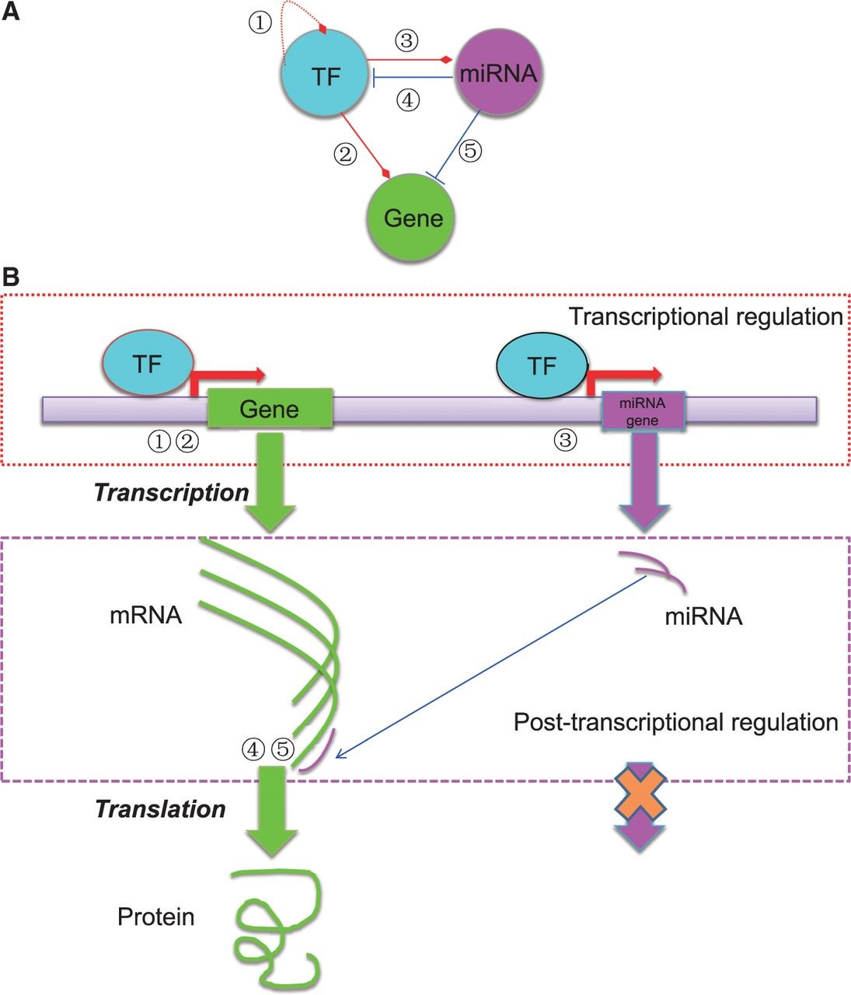
Figure 1. The basic regulatory circuit involving TF, miRNA and target gene ( A ) and the schematic illustration of the ...
Notes:
Figure 1. The basic regulatory circuit involving TF, miRNA and target gene ( A ) and the schematic illustration of the mechanisms of transcriptional and post-transcriptional regulation of gene expression ( B ). In total, five types of regulatory relationships are considered among TF, miRNA and target gene.
Unless provided in the caption above, the following copyright applies to the content of this slide: © The Author(s) 2015. Published by Oxford University Press. This is an Open Access article distributed under the terms of the Creative Commons Attribution License ( http://creativecommons.org/licenses/by/4.0/ ), which permits unrestricted reuse, distribution, and reproduction in any medium, provided the original work is properly cited.

Slide 2
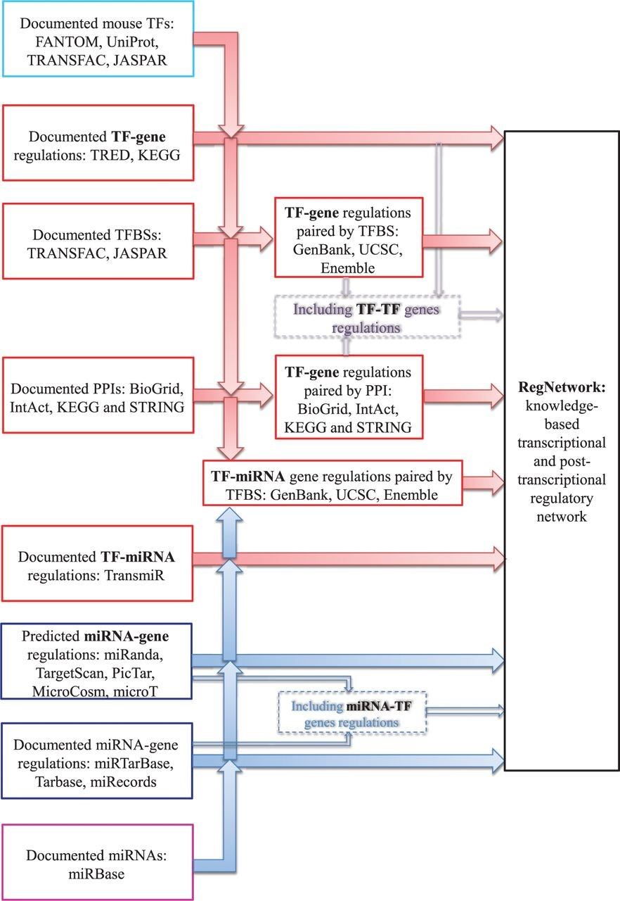
Figure 2. The flowchart for RegNetwork construction.
Notes:
Figure 2. The flowchart for RegNetwork construction.
Unless provided in the caption above, the following copyright applies to the content of this slide: © The Author(s) 2015. Published by Oxford University Press. This is an Open Access article distributed under the terms of the Creative Commons Attribution License ( http://creativecommons.org/licenses/by/4.0/ ), which permits unrestricted reuse, distribution, and reproduction in any medium, provided the original work is properly cited.

Slide 3
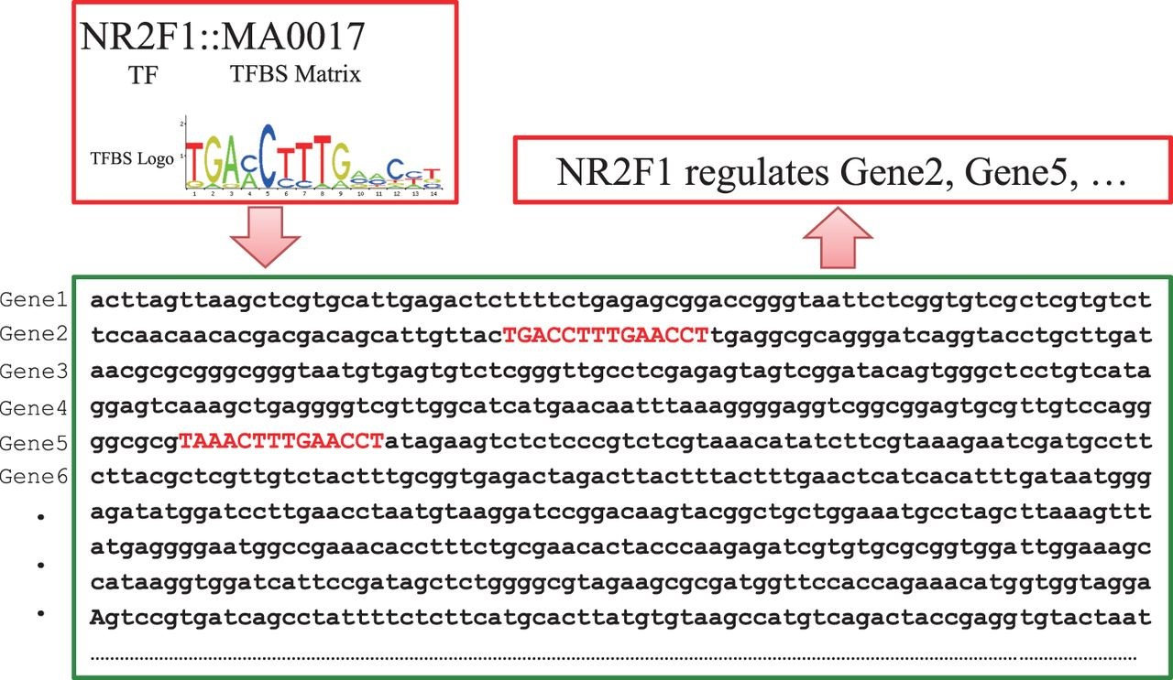
Figure 3. Schematic illustration of pairing TF and genes by TFBSs. When the documented TFBS ‘MA0017’ is found in the ...
Notes:
Figure 3. Schematic illustration of pairing TF and genes by TFBSs. When the documented TFBS ‘MA0017’ is found in the promoter regions of ‘Gene2’ and ‘Gene 5’, TF NR2F1 is predicted to have a potential to regulate the two genes accordingly.
Unless provided in the caption above, the following copyright applies to the content of this slide: © The Author(s) 2015. Published by Oxford University Press. This is an Open Access article distributed under the terms of the Creative Commons Attribution License ( http://creativecommons.org/licenses/by/4.0/ ), which permits unrestricted reuse, distribution, and reproduction in any medium, provided the original work is properly cited.

Slide 4
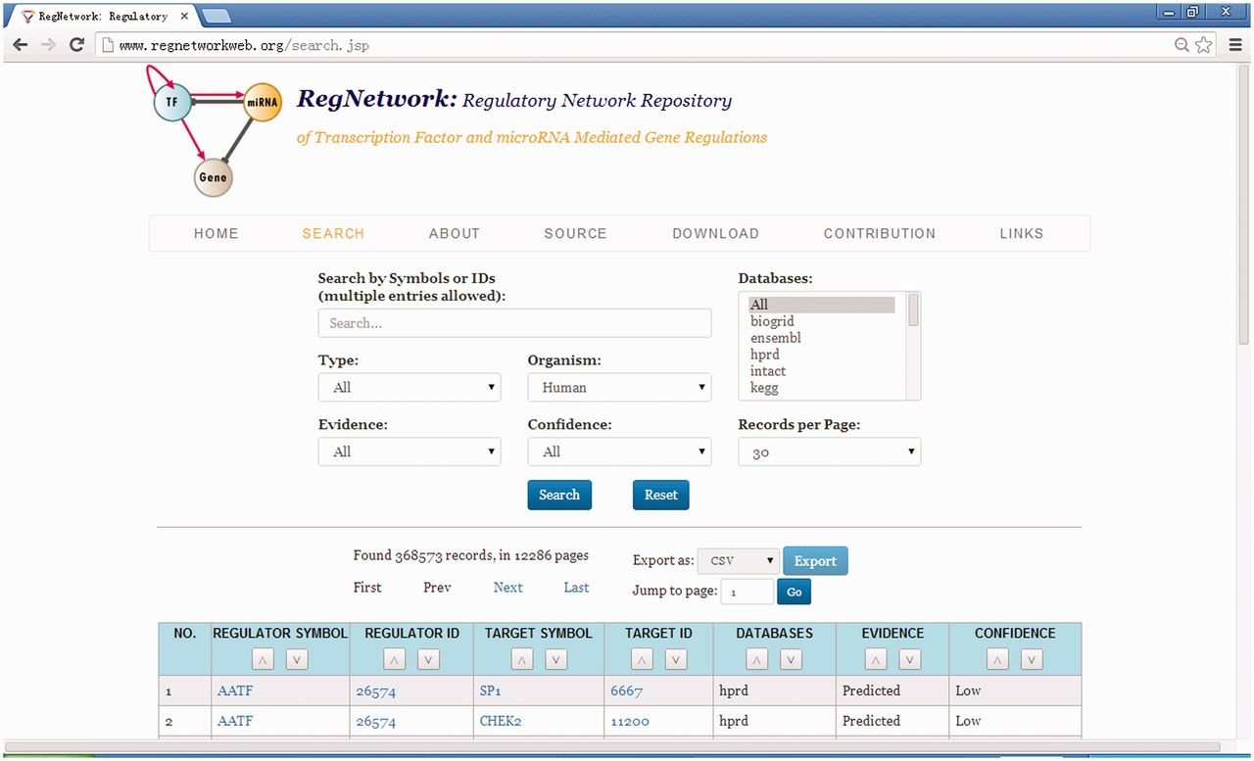
Figure 4. The web user interface of RegNetwork.
Notes:
Figure 4. The web user interface of RegNetwork.
Unless provided in the caption above, the following copyright applies to the content of this slide: © The Author(s) 2015. Published by Oxford University Press. This is an Open Access article distributed under the terms of the Creative Commons Attribution License ( http://creativecommons.org/licenses/by/4.0/ ), which permits unrestricted reuse, distribution, and reproduction in any medium, provided the original work is properly cited.

Slide 5
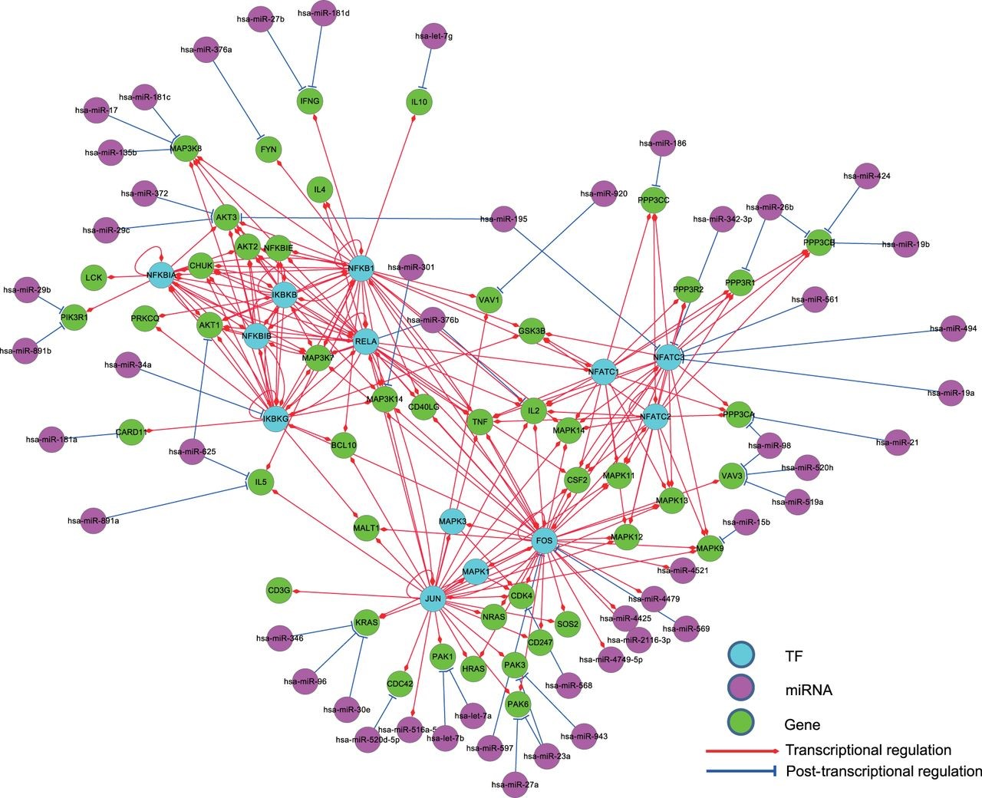
Figure 6. The regulatory relationships of a KEGG gene set for the human T cell receptor signaling pathway in ...
Notes:
Figure 6. The regulatory relationships of a KEGG gene set for the human T cell receptor signaling pathway in RegNetwork. TF, miRNA and gene are in different colors and the transcriptional and post-transcriptional interplays are shown in red and blue, respectively.
Unless provided in the caption above, the following copyright applies to the content of this slide: © The Author(s) 2015. Published by Oxford University Press. This is an Open Access article distributed under the terms of the Creative Commons Attribution License ( http://creativecommons.org/licenses/by/4.0/ ), which permits unrestricted reuse, distribution, and reproduction in any medium, provided the original work is properly cited.

Slide 6
Figure 5. The node degree distributions of the established regulatory networks in human ( A ) and mouse ( B ). A power ...
Notes:
Figure 5. The node degree distributions of the established regulatory networks in human ( A ) and mouse ( B ). A power law distribution in the form of y=α·x−γ is fitted in each subfigure, respectively. The results show that the node degrees satisfy the power-law distribution, i.e. y=α·x−γ=126697·x−2.179 , R2=0.845 in human, y=α·x−γ=99838·x−2.137 , R2=0.859 in mouse.
Unless provided in the caption above, the following copyright applies to the content of this slide: © The Author(s) 2015. Published by Oxford University Press. This is an Open Access article distributed under the terms of the Creative Commons Attribution License ( http://creativecommons.org/licenses/by/4.0/ ), which permits unrestricted reuse, distribution, and reproduction in any medium, provided the original work is properly cited.

