Slide 1
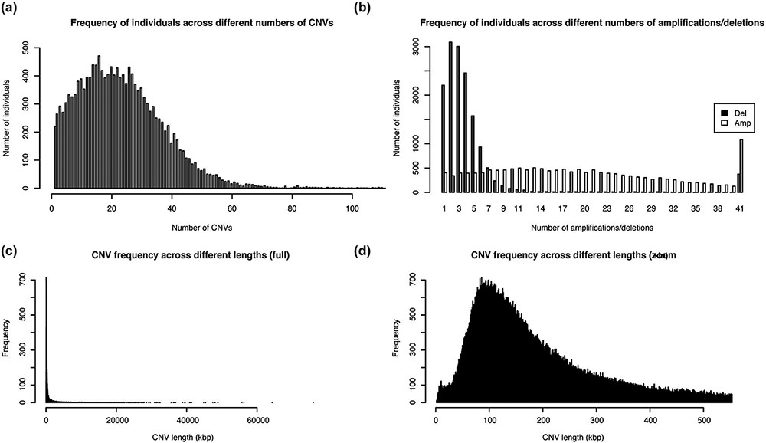
Figure 3. Distribution of the number and length of CNVs across the 15 829 Taiwanese people in TWCNV (a) Distribution of ...
Notes:
Figure 3. Distribution of the number and length of CNVs across the 15 829 Taiwanese people in TWCNV (a) Distribution of CNV counts in the population. (b) Distribution of duplication and deletion counts separately in the population. In (a) and (b), the number of individuals (y-axis) were plotted against the CNV counts (x-axis). (c) Distribution of lengths of the identified distinct CNVs. (d) Partial distribution of lengths of the identified distinct CNVs. In (d), CNV lengths ranging from 1 to 500 kb were further enlarged from the left figure. In (c) and (d), the unit of CNV lengths was kilobase pairs (kb) on the x-axis, and the exact CNV counts were shown on the y-axis.
Unless provided in the caption above, the following copyright applies to the content of this slide: © The Author(s) 2021. Published by Oxford University Press.This is an Open Access article distributed under the terms of the Creative Commons Attribution License (http://creativecommons.org/licenses/by/4.0/), which permits unrestricted reuse, distribution, and reproduction in any medium, provided the original work is properly cited.

